Slide 1
Integration of Sustainability Aspects into the Bachelor Programme in Mathematics
Andrii Dmytryshyn and Niklas Eriksen

Slide 2
Bachelor program in mathematics at ORU
Specialization: computational mathematics
19 mathematical courses, e.g., linear algebra, calculus, combinatorics, optimization, differential equations, and computational mathematics
4 courses on mathematics and society, e.g., mathematics, politics, and ethics; mathematics, history, and logics
Program responsible: Andrii Dmytryshyn (since 2023), Niklas Eriksen (until Dec 2022)

Slide 3
What does “integration” mean in practice?
Level 1. Including sustainability-oriented content.
Level 2. Engaging students in exercises or projects on sustainability-related topics.
Level 3. Adding sustainability-related learning objectives to courses.

Slide 4
How can mathematics contribute to sustainable development?
 | Environmental sustainability | Social sustainability | Economic sustainability
Mathematics for sustainability | Mathematical modeling and computations for the problems in sustainable development, e.g., arm-race model, SIR model, lake turbidity.
Sustainable mathematics | Carbon footprint of computing | Readability and usability

Slide 5
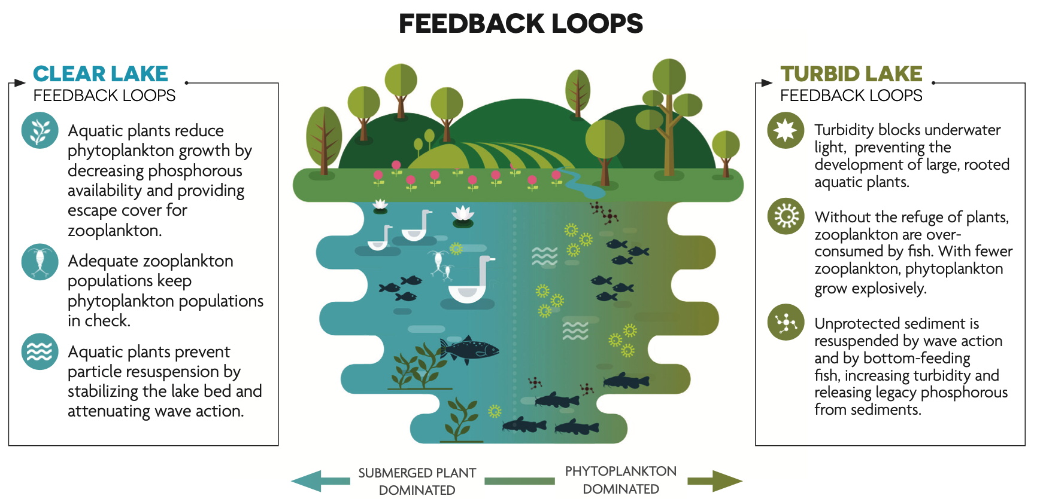
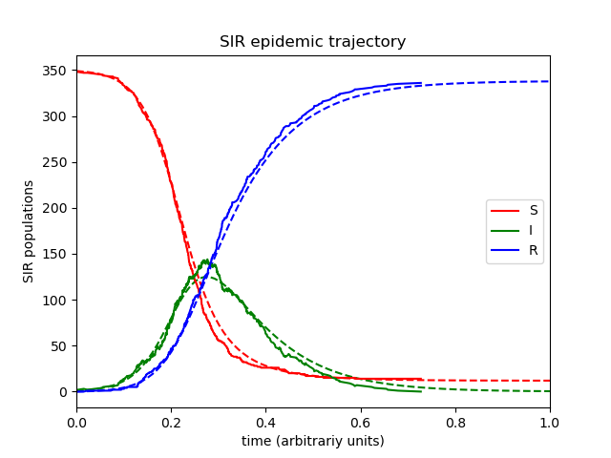
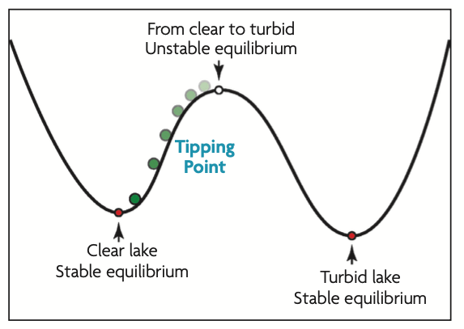
Mathematics for sustainability

Slide 6
Intergation of “Mathematics for sustainability”
MA157G, Mathematical modelling and problem solving (Level 2 integration)
MA155G, Combinatorics (Level 2 integration)

Slide 7
How can mathematics contribute to sustainable development?
 | Environmental sustainability | Social sustainability | Economic sustainability
Mathematics for sustainability | Mathematical modeling and computations for the problems in sustainable development, e.g., arm-race model, SIR model, lake turbidity.
Sustainable mathematics | Carbon footprint of computing | Readability and usability

Slide 8
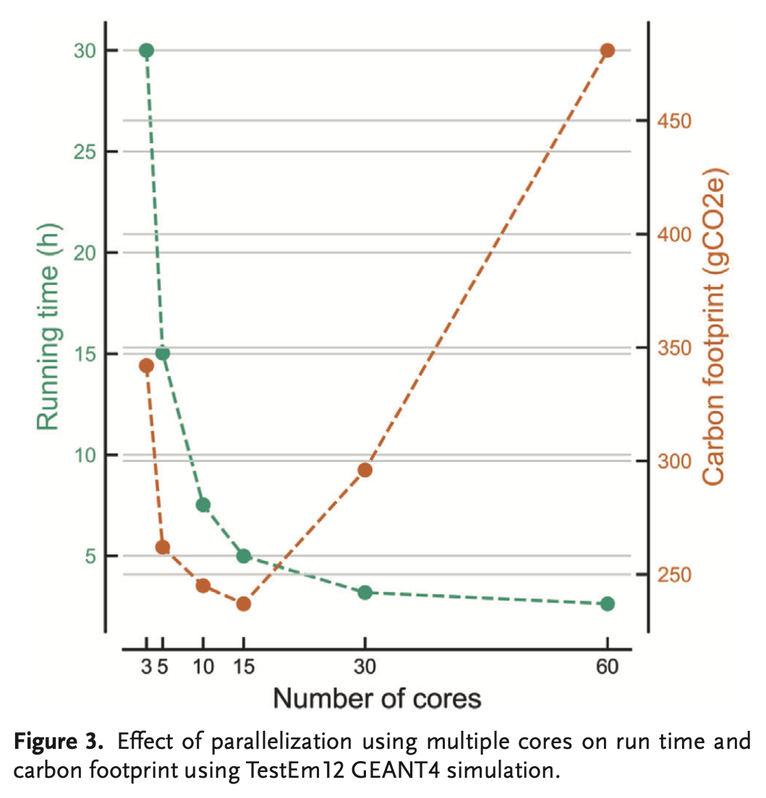
Sustainable mathematics: Carbon footprint of computing
Parallelism
L. Lannelongue, J. Grealey and M. Inouye, Green Algorithms: Quantifying the Carbon Footprint of Computation, Advanced Science, 2021.

Slide 9
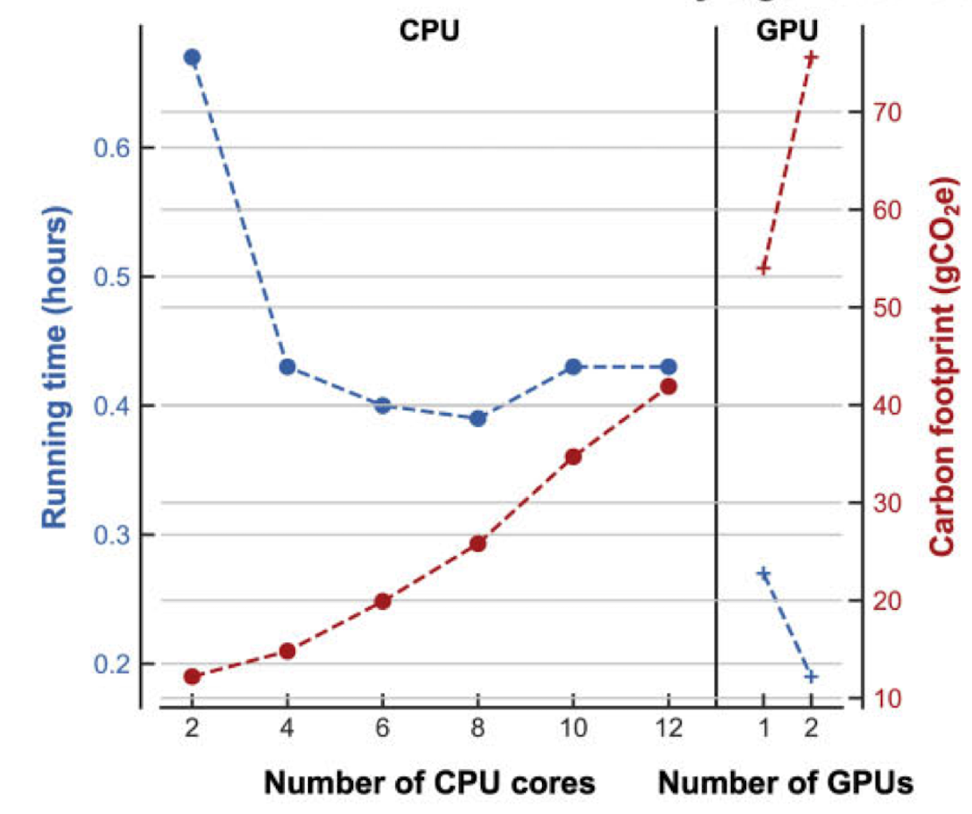
Sustainable mathematics: Carbon footprint of computing
CPU vs. GPU
Grealey, J., Lannelongue, L., Saw, W. Y., Marten, J., Méric, G., Ruiz-Carmona, S., & Inouye, M. (2022). The carbon footprint of bioinformatics. Molecular biology and evolution, 39(3)

Slide 10
Integration of “Sustainable mathematics”: Carbon footprint of computing
MA168G, Computational mathematics II (Level 3 integration) Lecture and discussion about quantifying environmental impact of computing. Identifying factors that the
impact depends on and which of these factors can be improved by using better computational methods.
Changes to the course plan: Add Hållbara beräkningar to the contents of the course.
MA169G, Case studies of computational mathematics. (Level 3 integration) Part 4 of the course is now dedicated to sustainable computing. Students are expected to read, discuss,
and present papers about environmental impact of computing. References suggested for Part 4:
Lannelongue, L., Grealey, J., Bateman, A., & Inouye, M. (2021).
Ten simple rules to make your computing more environmentally sustainable. PLOS Computational Biology, 17(9)
2. Grealey, J., Lannelongue, L., Saw, W. Y., Marten, J., Méric, G., Ruiz-Carmona, S., & Inouye, M. (2022).
The carbon footprint of bioinformatics. Molecular biology and evolution, 39(3)
Change to the course plan: Uppdate the current contents to Innehållet i artiklar som
haft en epokgörande betydelse for den vetenskapliga utvecklingen inom beräkningsmatematik
och artiklar om hållbara beräkningar.

Slide 11
How can mathematics contribute to sustainable development?
 | Environmental sustainability | Social sustainability | Economic sustainability
Mathematics for sustainability | Mathematical modeling and computations for the problems in sustainable development, e.g., arm-race model, SIR model, lake turbidity.
Sustainable mathematics | Carbon footprint of computing | Readability and usability

Slide 12
Sustainable mathematics: Readability and usability
How can we make sure that our results are understood and used properly?

Slide 13
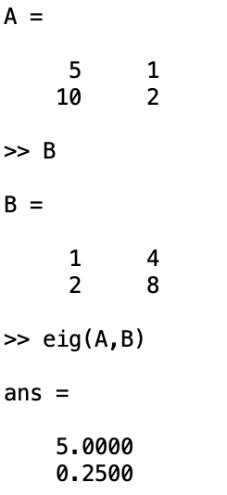
Sustainable mathematics: Readability and usability
How can we make sure that our results are understood and used properly?

Slide 14
Integration of “Sustainable mathematics”: Readability and usability
MA172G, Mathematics, politics, and ethics (Level 3 integration) Changes to the course plan:
Added the learning objective Efter avslutad kurs ska den studerande känna till hållbarhetsfrågor som är aktuella för matematik och matematiker.
Added the learning objective Efter avslutad kurs ska den studerande kunna avseende jämställdhet, hållbarhet, och etik i relevanta frågeställningar.
Added Hållbar matematik och matematik för hållbar utveckling to the contents of the course.
MA163G, Computational mathematics I (Level 2 integration)
Discussion about the importance of reproducibility in research and therefore of reproducibility of numerical experiments and readability of code.
Changes to the course plan: Change the contents Matlabprogrammering to Matlabprogrammering: läsbarhet och reproducerbarhet.

