Slide 1
Development of a learning environment for anatomy education within sport sciences Pedagogical Development School of Health Sciences – Sport Division - University of Örebro Friday, September 29th, 2023
Högskolepedagogisk konferens

Slide 2
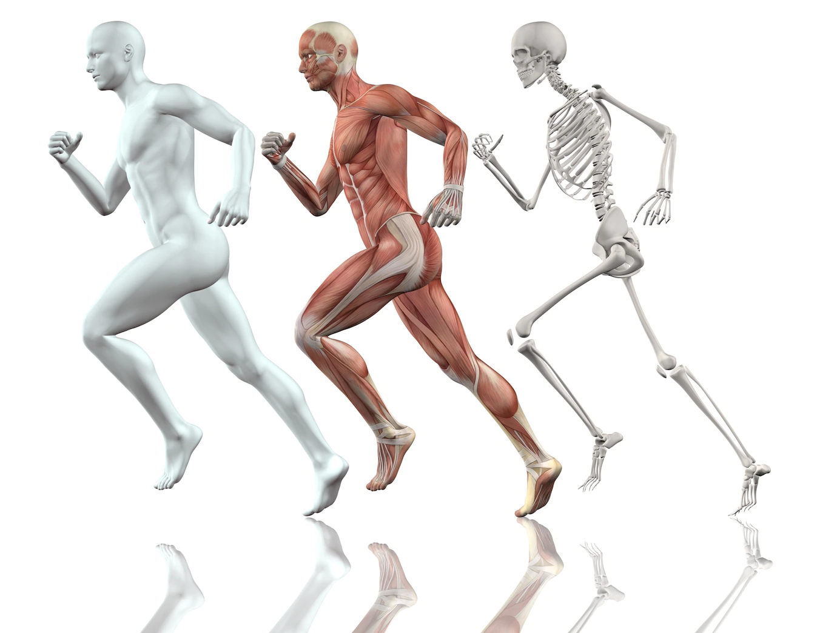
Anatomy education within sport sciences
Dedicated pedagogical support
Project presented in different forums
Undergraduate level
Training programme
Teacher programme: Physical Education & Health

Slide 3
Anatomy education within sport sciences
Demanding & time consuming
Changing student body
Increased range in learning alternatives
Digitalisation within education

Slide 4
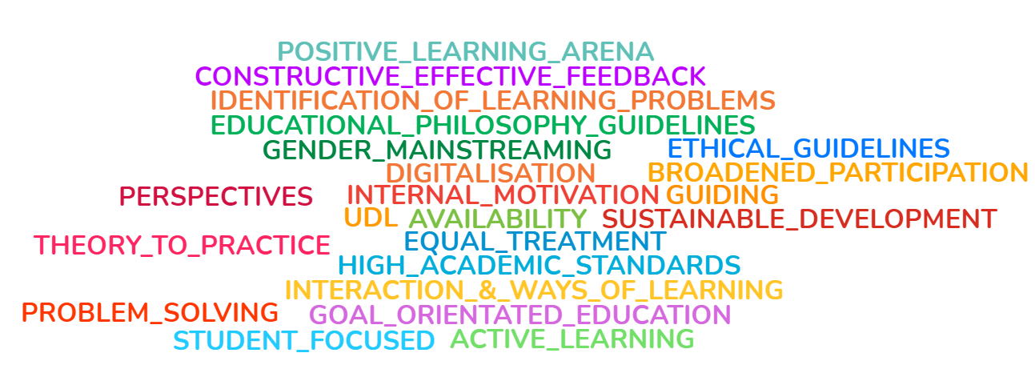
Learning Environment
Pedagogical
Dimension
Social
Dimension
Learning
Environment
Space
Dimension
Source: Adapted from Framtidens Lärarutbildning Rapport [2022:1]

Slide 5
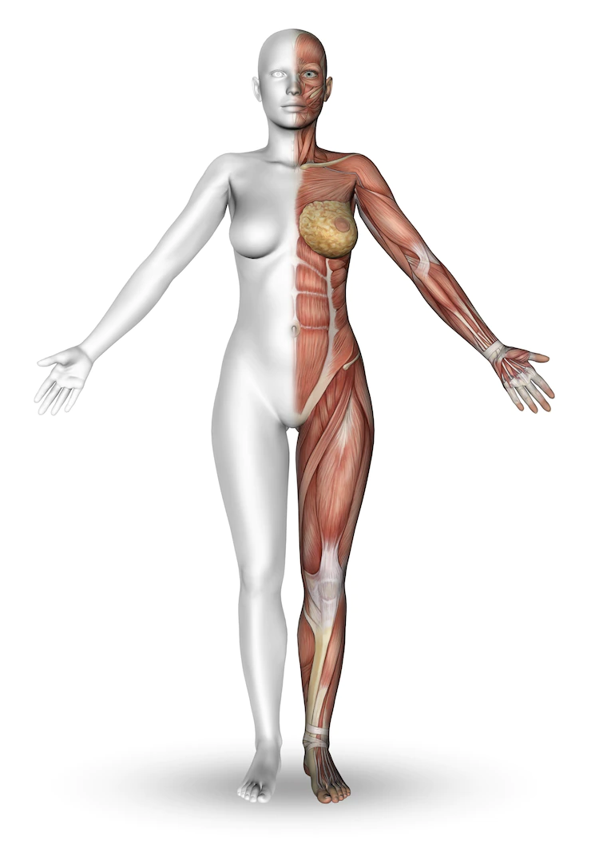
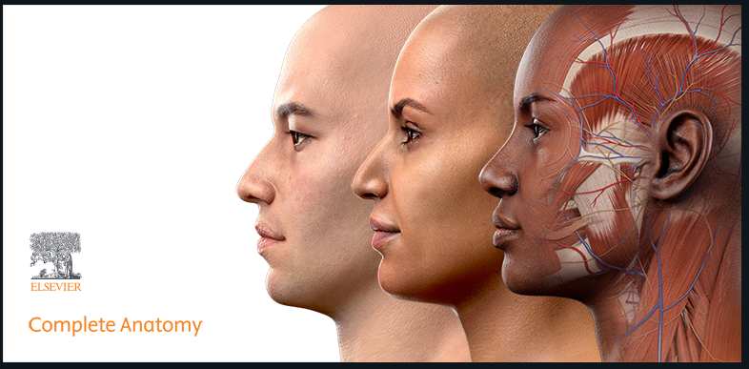
The teaching elements
Model of lecture
Model of group meeting (G115)
Model of learning module in LMS/Cloud
Student view & Repository
Complemented with digital tools

Slide 6
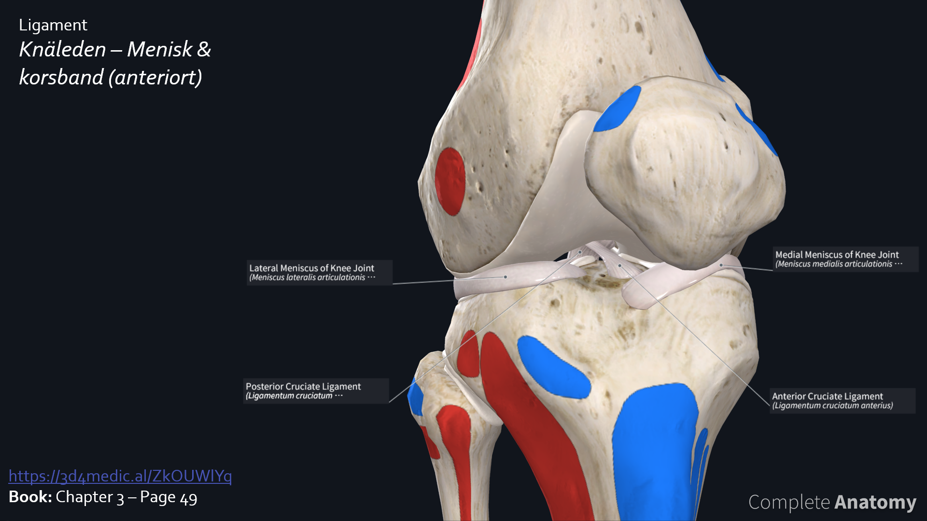
The teaching elements - Lecture

Slide 7
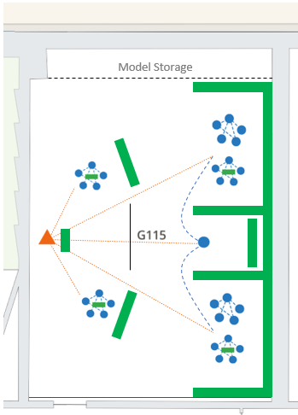
The teaching elements – Group meeting
1) Complete Anatomy Station
2) Study guide
3) Poster / Puzzles
4) Wooclap competition
3.
1.
4.
2.

Slide 8
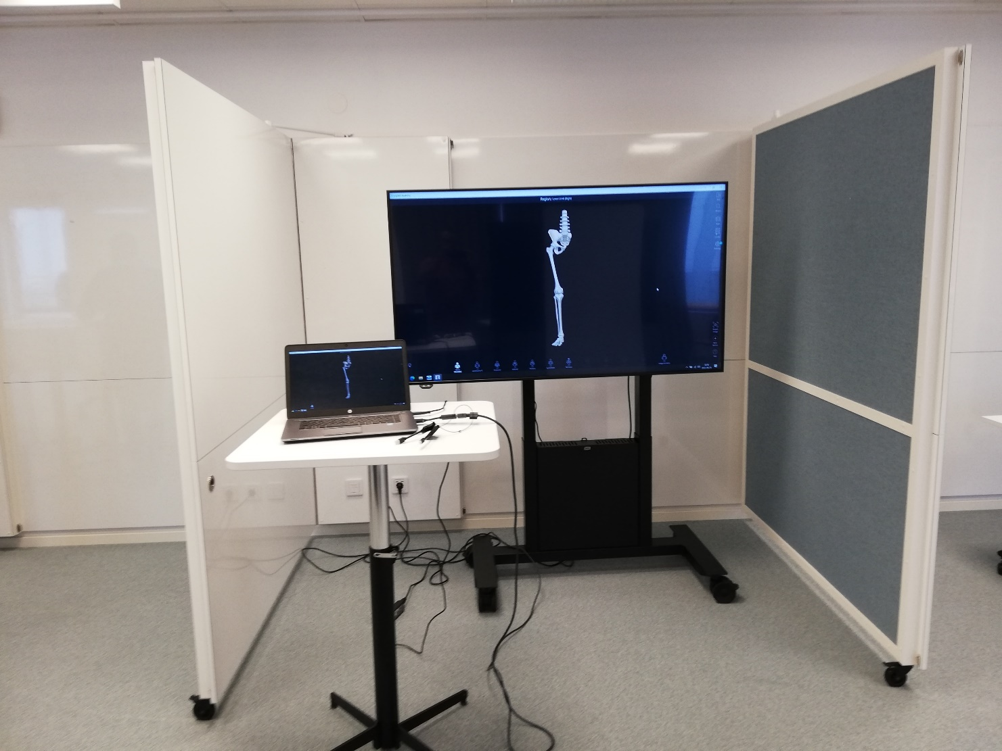
The teaching elements – Group meeting
1) Complete Anatomy Station
2) Study guide
3) Poster / Puzzles
4) Wooclap competition

Slide 9
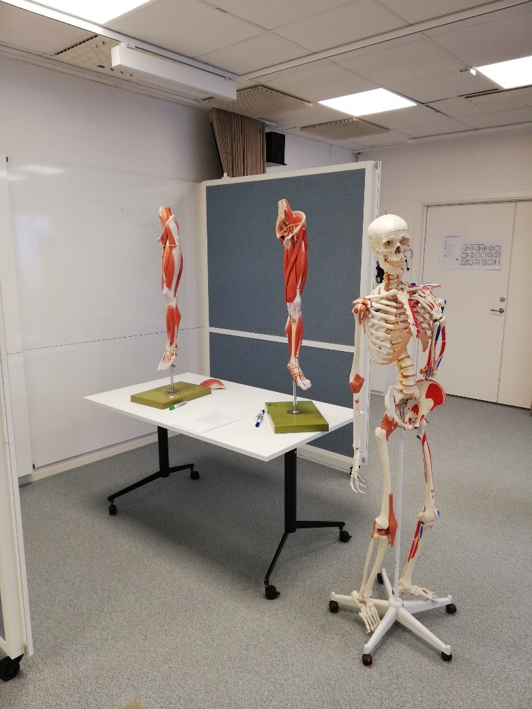
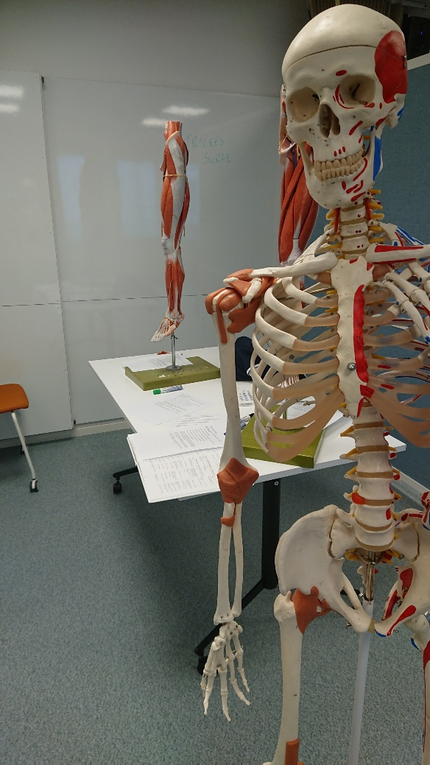
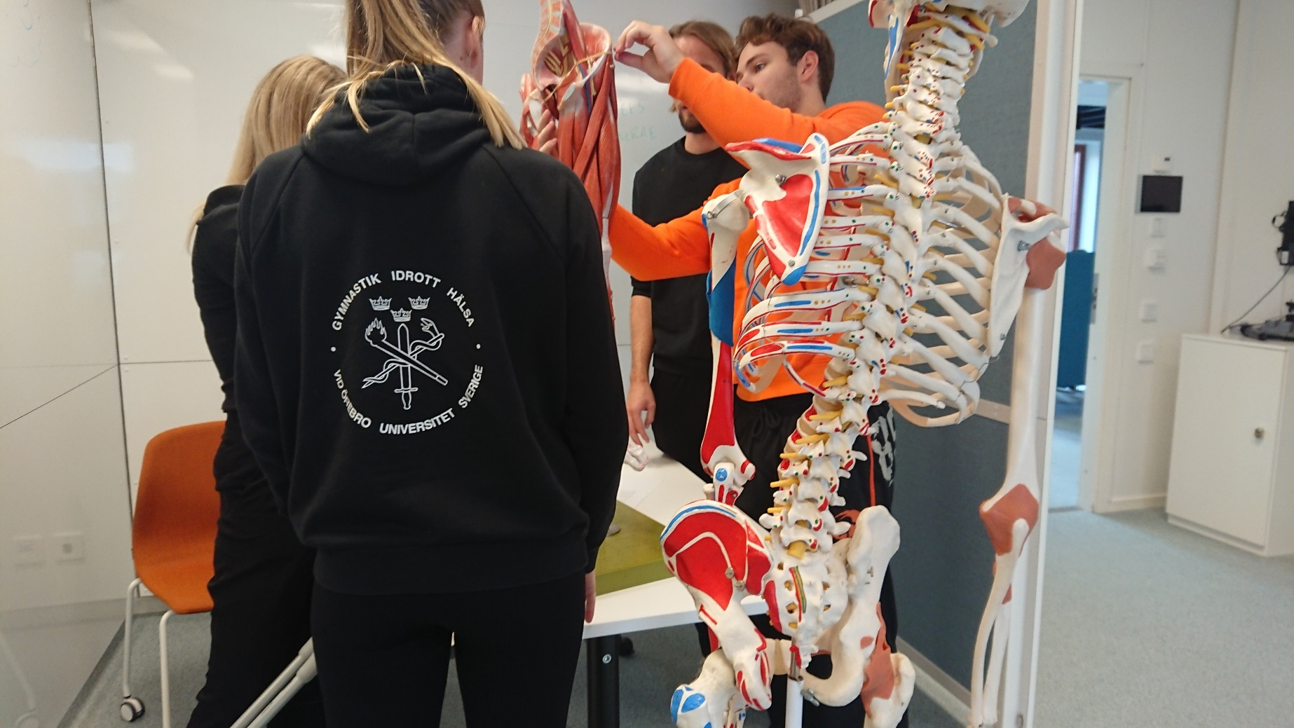
The teaching elements – Group meeting
1) Complete Anatomy Station
2) Study guide
3) Poster / Puzzles
4) Wooclap competition

Slide 10
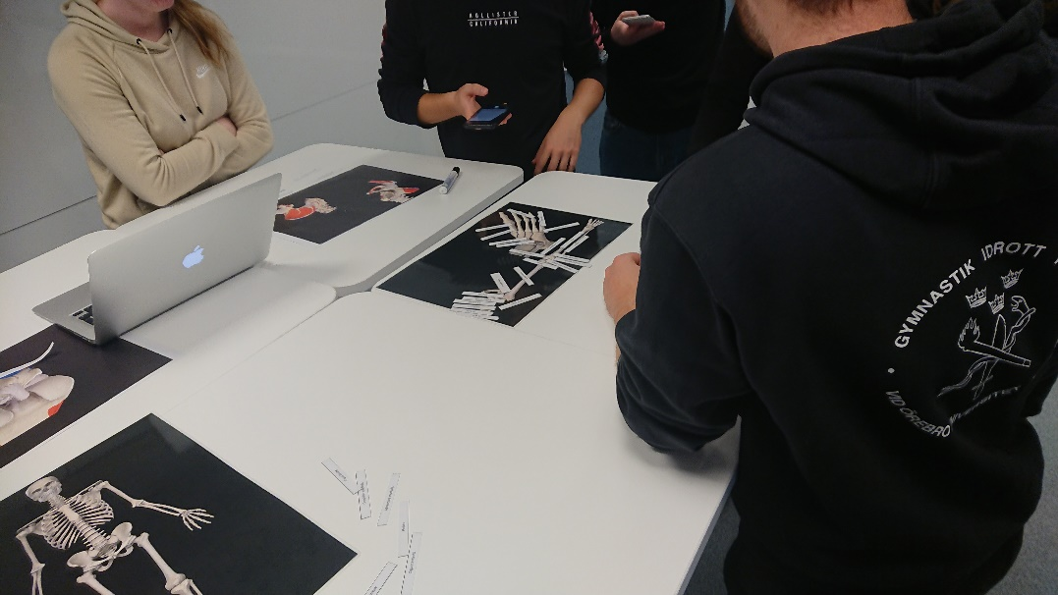
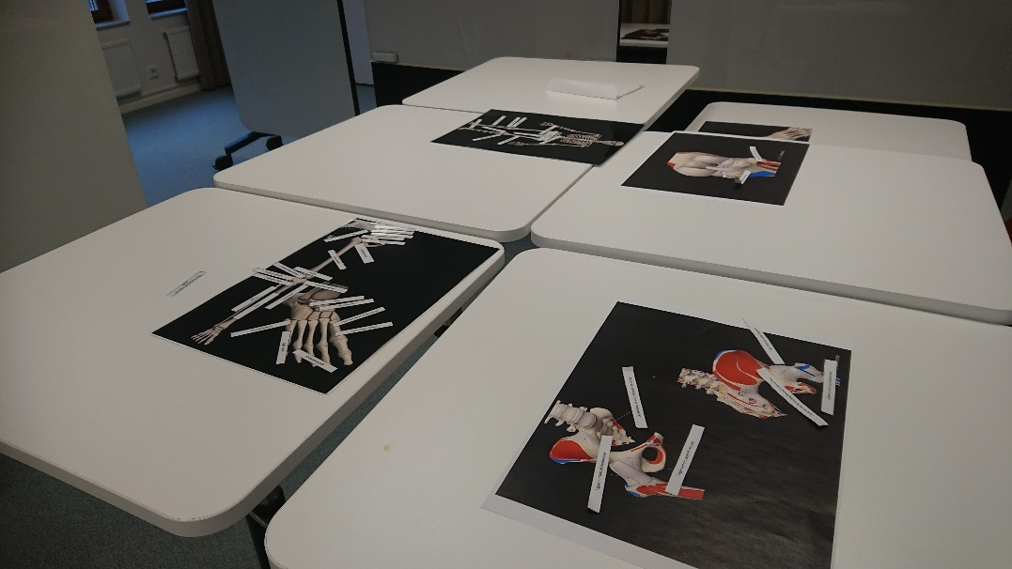
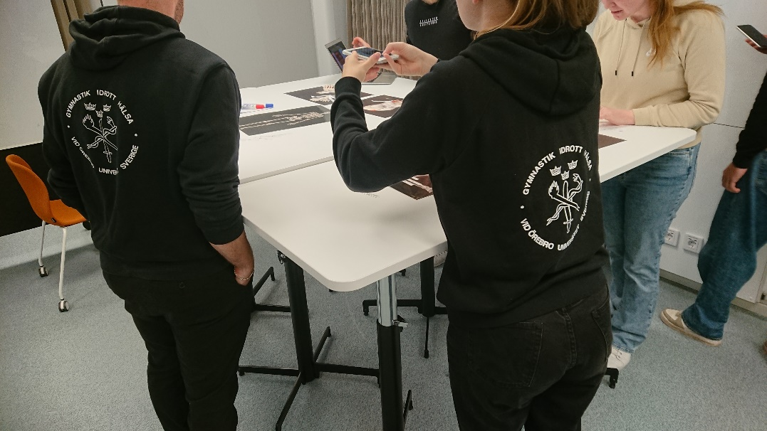
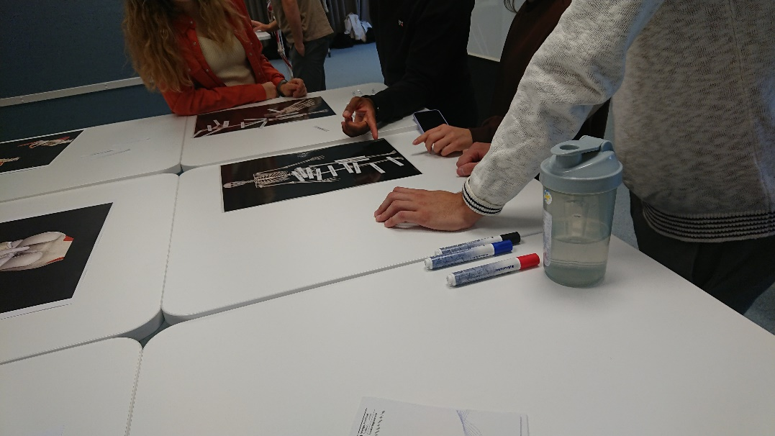
The teaching elements – Group meeting
1) Complete Anatomy Station
2) Study guide
3) Poster / Puzzles
4) Wooclap competition

Slide 11
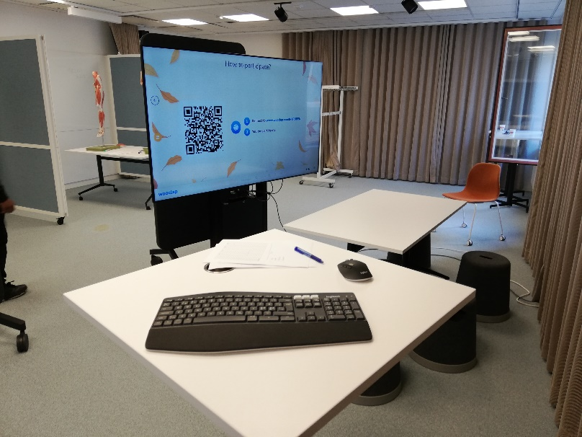
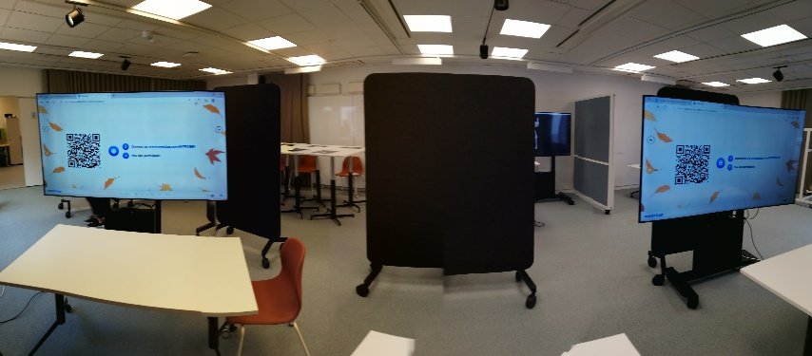
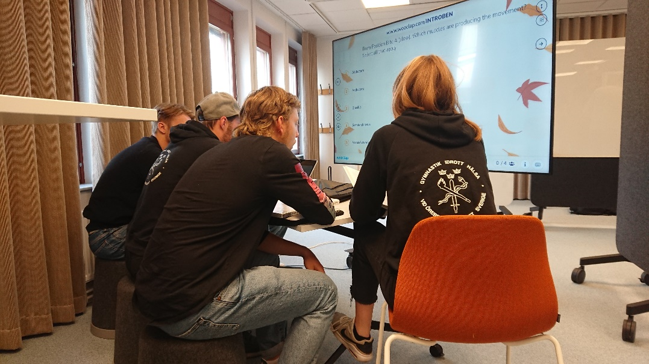
The teaching elements – Group meeting
1) Complete Anatomy Station
2) Study guide
3) Poster / Puzzles
4) Wooclap competition

Slide 12
The teaching elements – Group meeting
Positive using different learning approaches
Stimulating learning envirorment
Complete Anatomy good as a complement
Facilitate observations about how students address challenges & identify learning problems

Slide 13
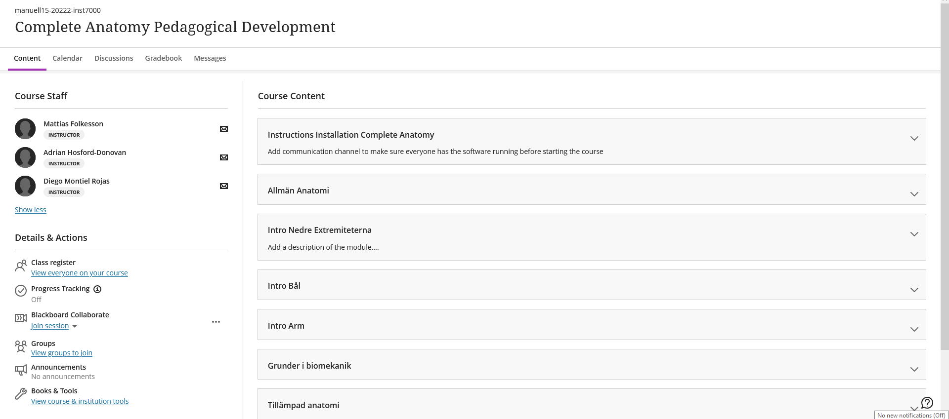
The teaching elements – Learning Module
Repository

Slide 14
The teaching elements – Learning Module
Repository
One Drive cloud: 2 levels of privileges

Slide 15
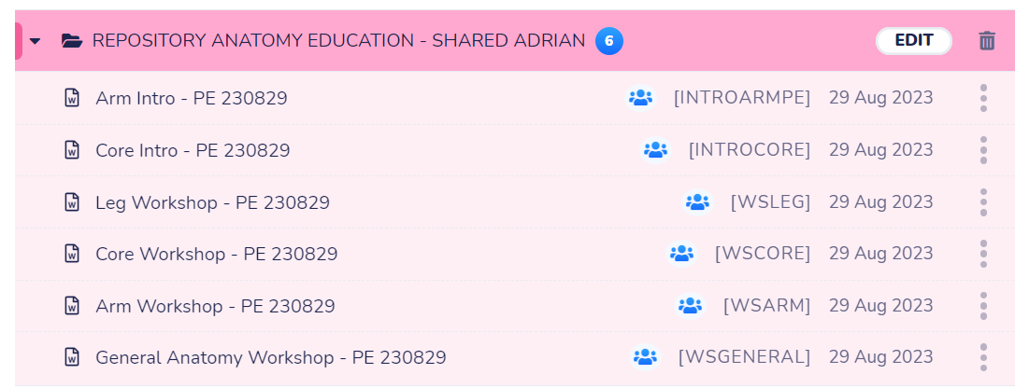
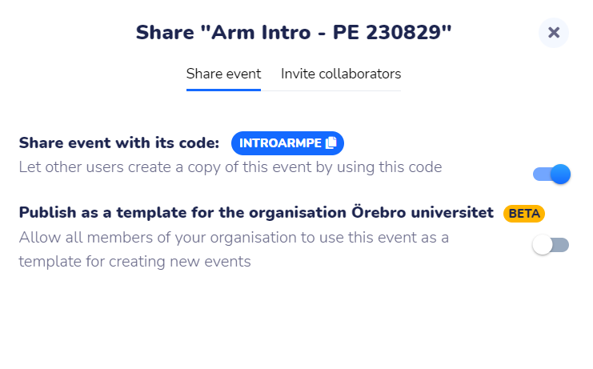
The teaching elements – Learning Module
Repository
Wooclap: Create a copy

Slide 16
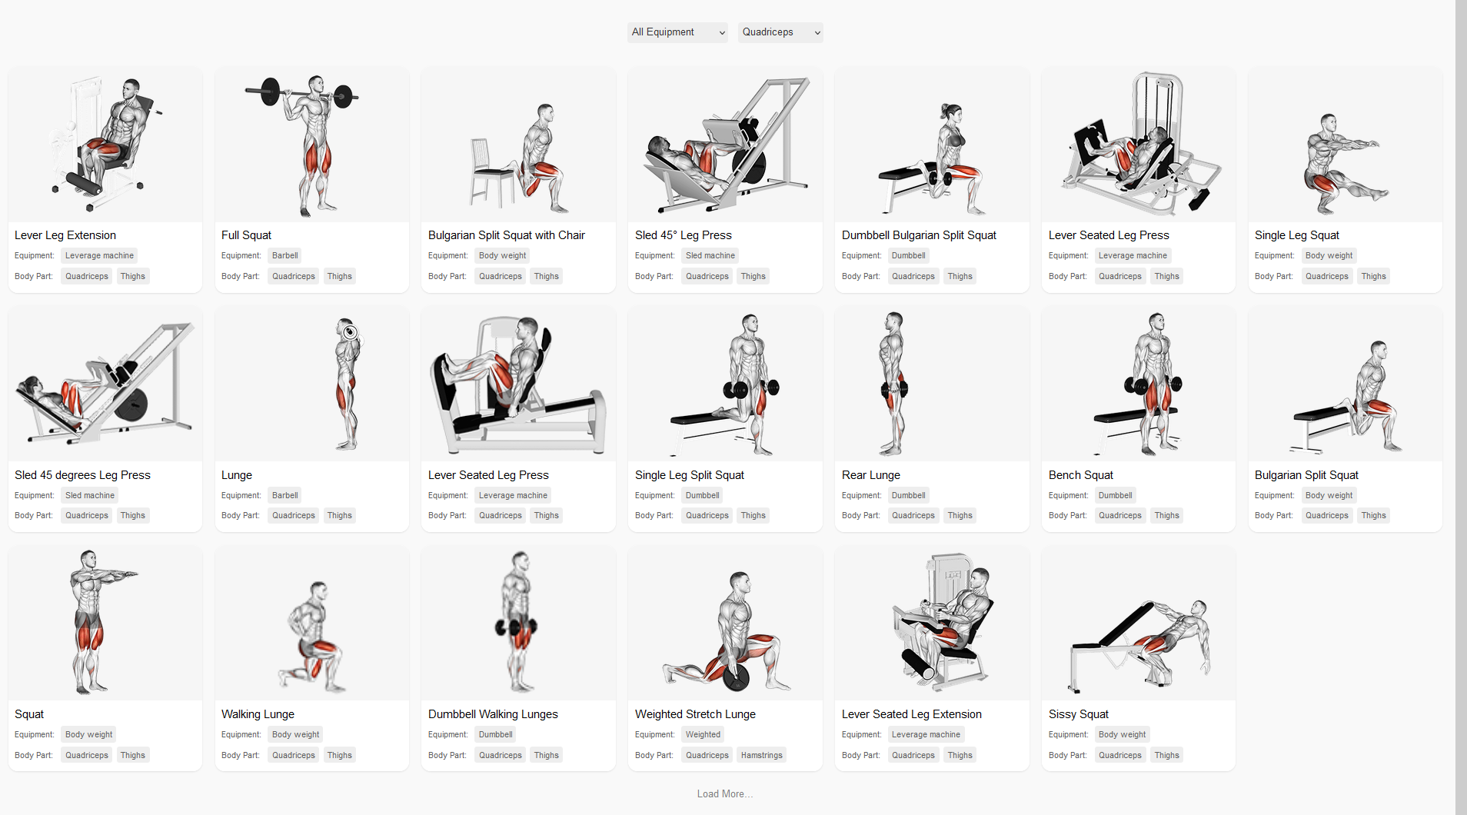
The teaching elements – Other tools
Source: Lyfta.app

Slide 17
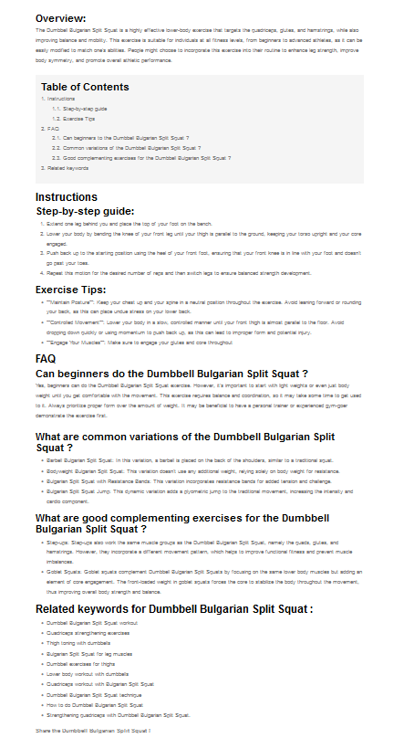
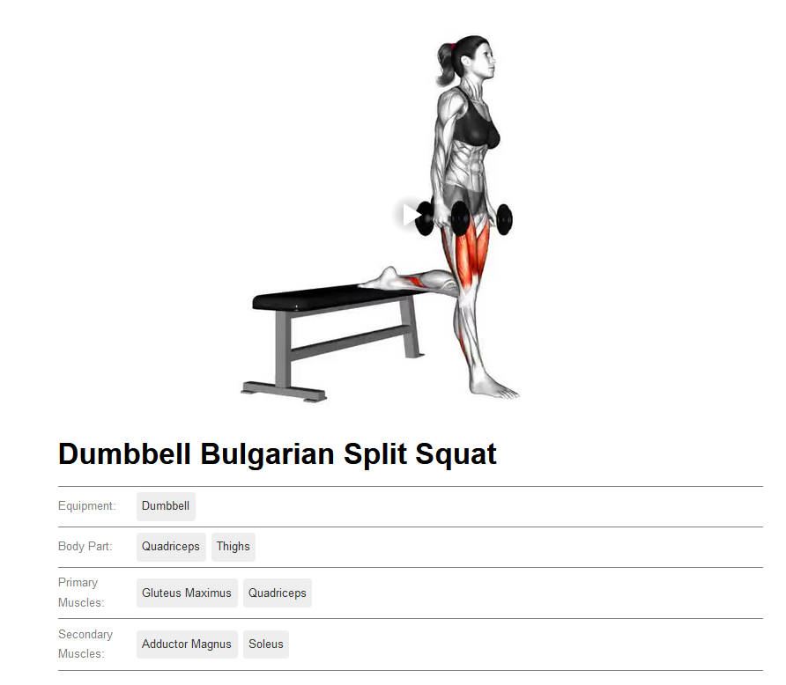
The teaching elements – Other tools
Source: Lyfta.app

Slide 18
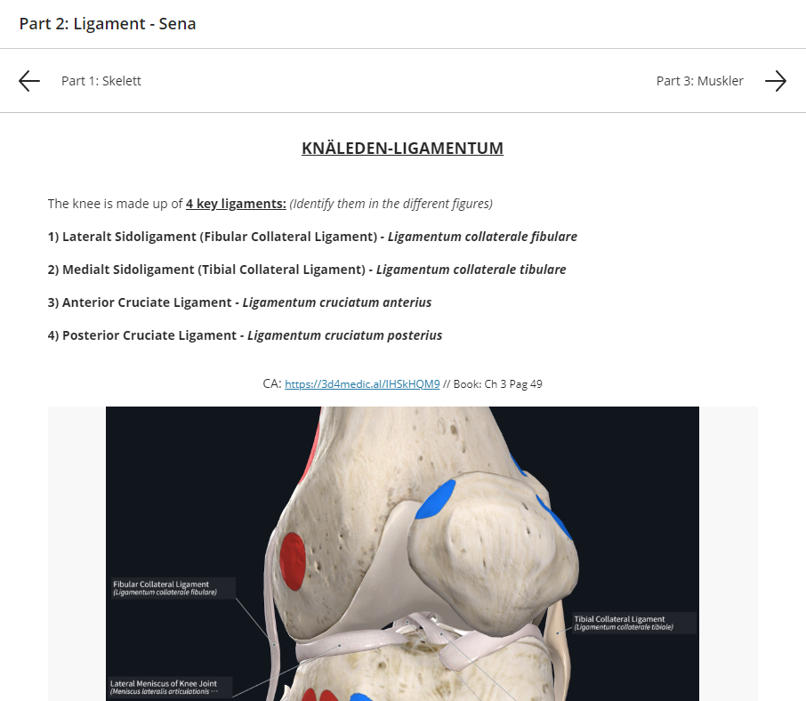
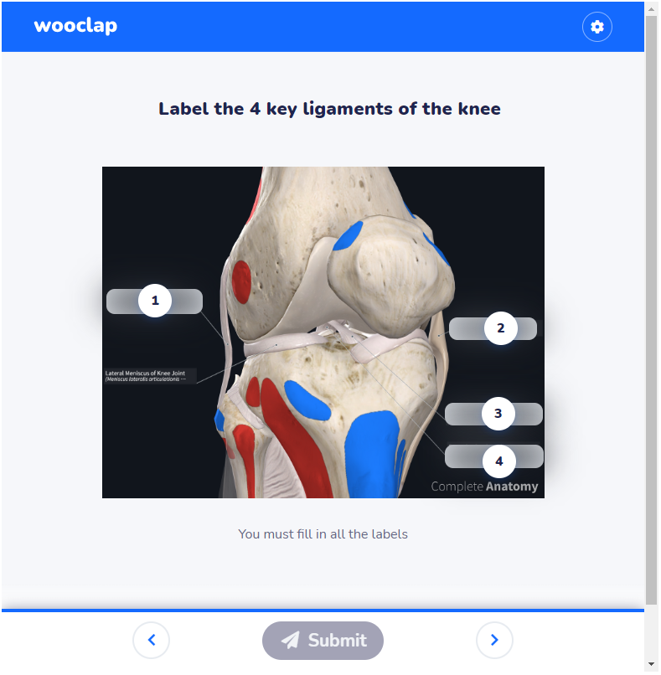
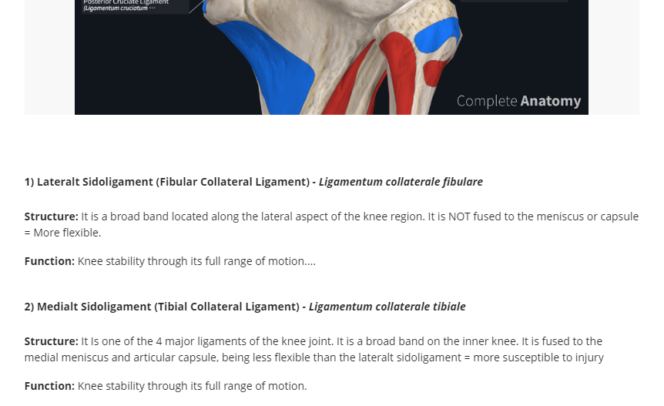
The teaching elements – Learning Module
Student View

Slide 19
Learning Environment
Pedagogical
Dimension
Social
Dimension
Learning
Environment
Space
Dimension
Source: Adapted from Framtidens Lärarutbildning Rapport [2022:1]

Slide 20
Milestones…
G115 (almost) ready to be used as piloted
Same approach applicable to other subjects
Possibility of producing research knowledge in the topic
Model to be tested in a new pedagogical development project in interprofessional teaching

Slide 21
Thank you!
Diego Montiel Rojas - Adrian Hosford-Donovan - Mattias Folkesson
Special thanks to: Eva-Lena Klaasma, Samuel Edelbring & Anna-Eva Olsson

