Slide 1
Collaborative knotworking: Transforming clinical teaching practice through faculty development
Agnes Elmberger, PhD Student
Matilda Liljedahl, Erik Björck, Juha Nieminen, Klara Bolander Laksov
Dep. of Learning, Informatics, Management and Ethics
Karolinska Institutet, & Stockholm University
agnes.elmberger@ki.se

Slide 2
FACULTY DEVELOPMENT
“Activities (health) professionals pursue to improve their knowledge, skills and behaviours as teachers” (Steinert 2014, p.4)

Slide 3
THE PROBLEM
Effectiveness and outcomes
(e.g. Amundsen & Wilson 2012; Gibbs & Coffey 2004; Steinert et al. 2016, Stes 2010)
Scope and nature
(Amundsen & Wilson 2012; Leslie et al. 2013; Sorinola et al. 2017; Steinert et al. 2016)
Knowledge transfer
?
Photo: Cronberg, E. People at KTC

Slide 4
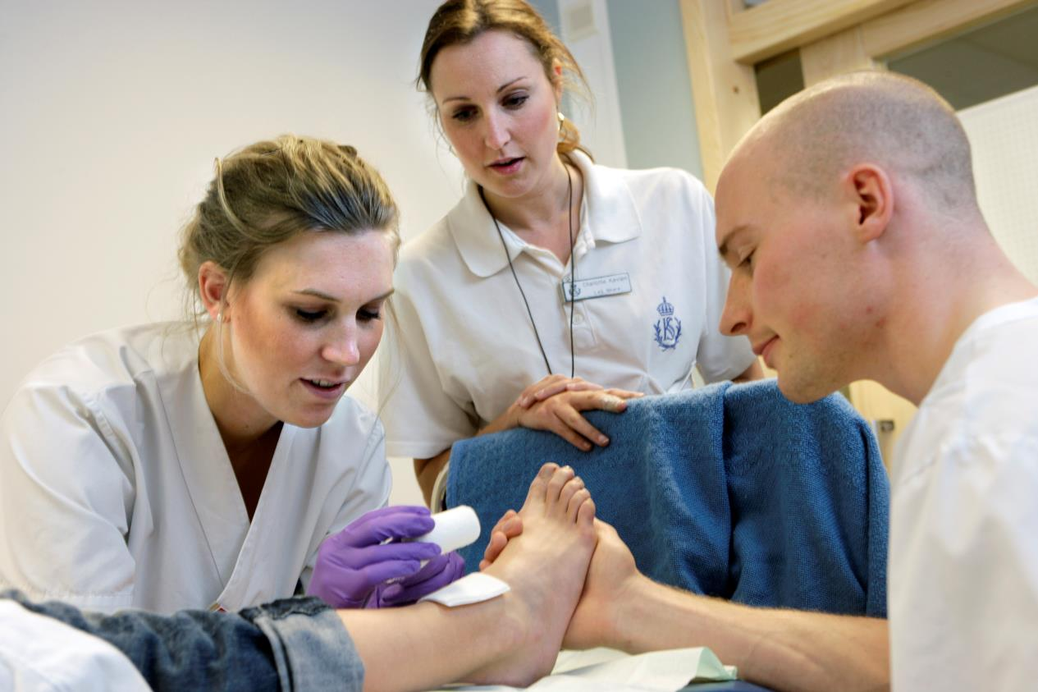
THE QUESTION
How do clinical teachers integrate pedagogical ‘tools’ developed in faculty development into clinical settings?

Slide 5
THE METHOD
Activity theory
14 clinical teachers, different professions
Focus group interviews
Thematic analysis (Braun & Clarke, 2006)

Slide 6
ACTIVITY THEORY
Analysis of complex interactions between systems and individuals (Engeström 1999, Varpio 2017)
The activity system
Contradictions within and between activities
(Engeström 1987; Virkkunen and Newnham 2013)
Tools
Subject
Object
Outcome
Rules
Division of labour
Community

Slide 7
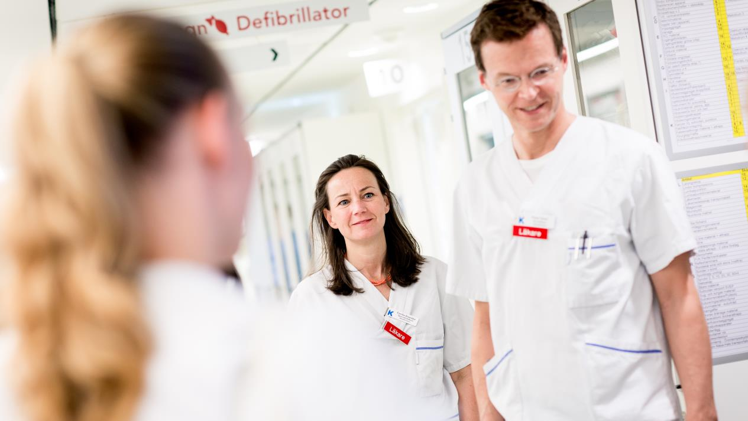
THE CONTEXT
One-year faculty development program
Develop and transfer educational innovations into workplace
(Bolander Laksov et al. 2020)

Slide 8
Pedagogical tools developed
Pedagogical tools
Learning activity to train interprofessional communication, including change of schedule for clinical placement of students.
Learning activity to increase student understanding of inter professional rounds, including an educational film.
Educational film to support clinical supervisors in giving feedback
Reorganisation of clinical placements to enable peer learning between students and between clinical supervisors.
Learning activity to increase inter professional collaboration at rounds, including pedagogical tool consisting of interprofessiona check list.
Notes:
.

Slide 9
RESULTS
(A)
Faculty development system (academic context)
Workplace system (clinical context)
Tools
Generalized object Educating students to provide good patient care
Tools
Subject Faculty development participants
Specific object Maintaining routines of education and health care
Subject Teaching clinicians
Specific object Developing and integrating educational innovation
Rules
Community Faculty developers, peers in the programme
Division of labour
Division of labour
Community Clinical team, managers, students, patients
Rules
(B)
Collaborative knotworking
Transformation
Negotiation
Reconceptualisation
Reconciliation

Slide 10
RESULTS
Developing & transferring innovation
Team
Routine tasks
Clinician
FDP
CWP
Resistance to change
Unwillingness to use innovation

Slide 11
RESULTS
1. Negotiating a mandate for change
The Faculty development programme
Working in a team
Being an ’in-group’ peer
Educational formal roles that communicate

Slide 12
RESULTS
1. Negotiating a mandate for change
2. Reconceptualising the innovation
Iterative communication and interaction
Testing and changing the ’tool’
Accept changes in form and use

Slide 13
RESULTS
1. Negotiating a mandate for change
2. Reconceptualising the innovation
3. Reconciliation between systems
Varying degrees of change depend on extent of change required
Initial misalignment of objects reconciled
No clear end point, subject to re-negotiation

Slide 14
RESULTS
(A)
Faculty development system (academic context)
Workplace system (clinical context)
Tools
Generalized object Educating students to provide good patient care
Tools
Subject Faculty development participants
Specific object Maintaining routines of education and health care
Subject Teaching clinicians
Specific object Developing and integrating educational innovation
Rules
Community Faculty developers, peers in the programme
Division of labour
Division of labour
Community Clinical team, managers, students, patients
Rules
(B)
Collaborative knotworking
Transformation
Negotiation
Reconceptualisation
Reconciliation

Slide 15
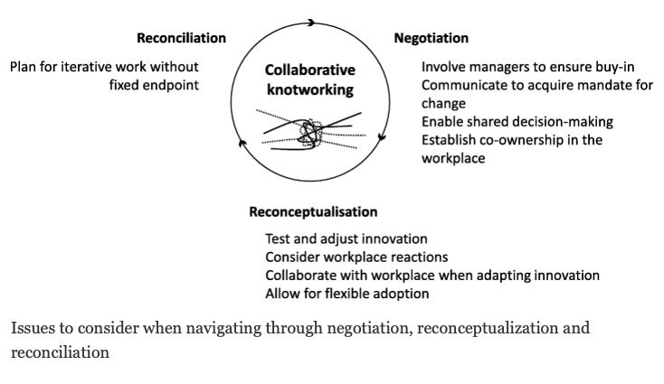

Slide 16
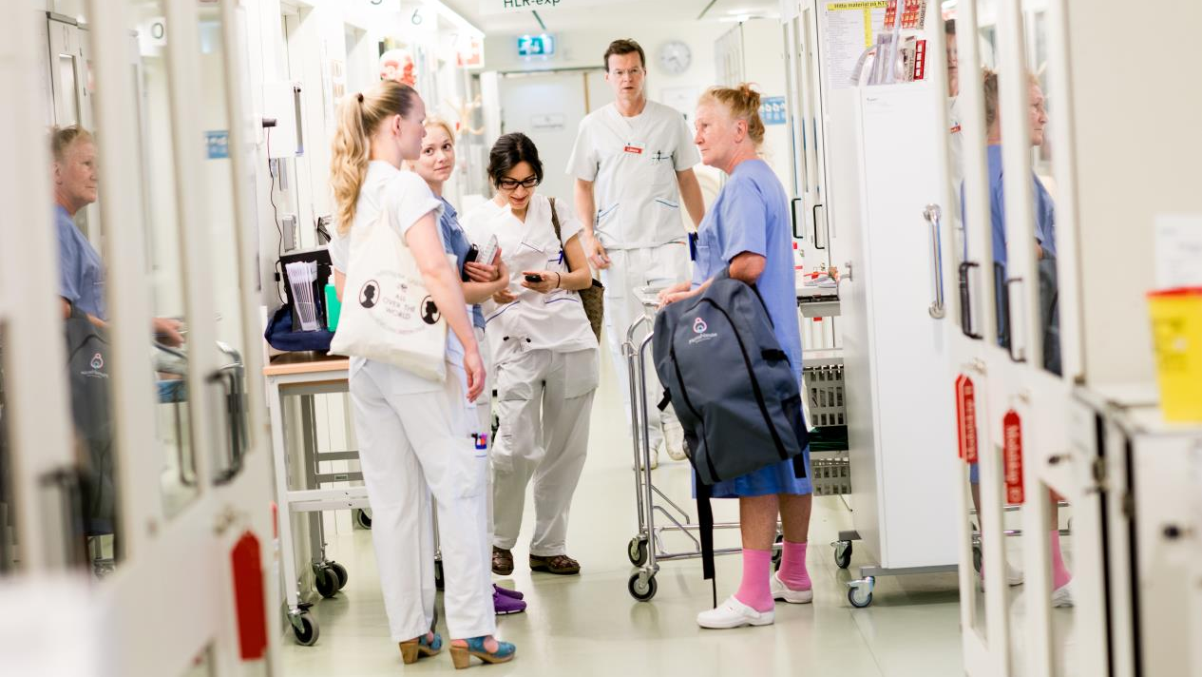
Educational change is local:
Collaborative knotworking requires transformation of the workplace as well as the innovation/ innovator
The workplace needs to be an agent in faculty development

Slide 17
Thank you!
Collaborators:
Matilda Liljedahl, Erik Björck, Juha Nieminen, Klara Bolander Laksov
Funding:
Stockholm City Council
The Swedish Society of Medicine
Karolinska Institutet
agnes.elmberger@ki.se
Notes:
However, applying AT in this study enabled us to go beyond an individual account of why CT engage in edu dev. Instead we could aim at a systemic understanding of how their engagement is influenced by the context they are acting within and the community they are part of. Knowing this will hopefully enable edu developers in universities and leaders in teaching hospitals to better understand what kind of support CT need and how they can offer that support.
Click
Complex issues need theories that attend to their complexity. AT is such a theory. It is well-suited for studying interactions between the individual, the social and the surrounding context and it also pays attention to contradictions in and between activities.
Lastly, I hope that I now have given you some ideas of how AT can be used in medical education research, and perhaps more important, why it should be used.

Slide 18
Our publications in this project
Bolander Laksov, K., Elmberger, A., Liljedahl, M., & Björck, E. (2020). Shifting to Team-based Faculty Development: a Programme designed to facilitate change in Medical Education. Higher Education Research & Development, 1-15.
Elmberger, A., Björck, E., Liljedahl, M., Nieminen, J., & Laksov, K. B. (2019). Contradictions in clinical teachers’ engagement in educational development: an activity theory analysis. Advances in Health Sciences Education, 24(1), 125-140.
Elmberger, A., Björck, E., Nieminen, J., Liljedahl, M., & Laksov, K. B. (2020). Collaborative knotworking–transforming clinical teaching practice through faculty development. BMC medical education, 20(1), 1-11.

Slide 19
References
Amundsen, C., & Wilson, M. (2012). Are we asking the right questions? A conceptual review of the educational development literature in higher education. Review of Educational Research, 82(1), 90–126. doi:10.3102/0034654312438409
Braun, V., & Clarke, V. (2006). Using thematic analysis in psychology. Qualitative Research in Psychology, 3(2), 77–101. doi:10.1191/1478088706qp063oa
Engeström, Y. (1987). Learning by expanding: An activity-theoretical approach to developmental research. Helsinki: Orienta-konsultit.
Engeström, Y., Miettinen, R., & Punamäki, R.-L. (1999). Perspectives on activity theory. Cambridge: Cambridge University Press.
Gibbs, G., & Coffey, M. (2004). The impact of training of university teachers on their teaching skills, their approach to teaching and the approach to learning of their students. Active Learning in Higher Education, 5(1), 87–100. doi:10.1177/1469787404040463
Leslie, K., Baker, L., Egan-Lee, E., Esdaile, M., & Reeves, S. (2013). Advancing Faculty Development in Medical Education. Academic Medicine, 88(7), 1038–1045. doi:10.1097/ACM.0b013e318294fd29
Sorinola, O. O., Thistlethwaite, J., Davies, D., & Peile, E. (2017). Realist evaluation of faculty development for medical educators : What works for whom and why in the long-term. Medical Teacher, 39(4), 422–4

Slide 20
References
Steinert, Y. (2014). Faculty Development: Core Concepts and Principles. In Y. Steinert (Ed.), Faculty Development in the Health Professions: A Focus on Research and Practice (pp. 3–25). New York London: Springer Dordrecht Heidelberg.
Steinert, Y., Mann, K., Anderson, B., Barnett, B. M., Centeno, A., Naismith, L., et al. (2016). A systematic review of faculty development initiatives designed to enhance teaching effectiveness: A 10-year update: BEME Guide No. 40. Medical Teacher, 38(8), 769–786. doi:10.1080/0142159X.2016.1181851
Stes, A., Min-Leliveld, M., Gijbels, D., & Van Petegem, P. (2010). The impact of instructional development in higher education: The state-of-the-art of the research. Educational Research Review, 5(1), 25–49. doi:10.1016/j.edurev.2009.07.001
Varpio, L., Aschenbrener, C., & Bates, J. (2017). Tackling wicked problems: How theories of agency can provide new insights. Medical Education, 51(4), 353–365. doi:10.1111/medu.13160
Virkkunen, J., & Newnham, D. S. (2013). The change laboratory: A tool for collaborative development of work and education. Rotterdam: Sense Publishers.

Slide 21
Photos
http://mediabank.ki.se/
Sirborn, U. Aula Medica, (CC), alterations of picture: black-white
Svensk, C. Education, (CC), alterations of picture: black-white
Skog, L. kiutbildning5626.jpg, (CC), alterations of picture: black-white
Cronberg, E. Doctors at KTC, (CC), alterations of picture: black-white
Cronberg, E. People at KTC, (CC), alterations of picture: black-white

