Slide 1
Estimation of labor migration impact on the labor force demand and supply in Ukraine on base of combining data from different sources
BaNoCoSS – 2019, 16-20 June 2019, Örebro, Sweden
Volodymyr Sarioglo
Ptoukha Institute for Demography and Social Studies

Slide 2
Problems
In recent years Ukrainian economy faced considerable difficulties due to the 2014 political and economic crisis and the significant slowdown of the economy. Several important challenges affecting the Ukrainian labor market are: a structural reform of the economy, primarily a significant decrease of shares of manufacturing, as well as within the mining and quarrying sectors; significant labor migration; ageing of the population, especially in rural area. Further changes of production processes and related reforms in the education and training systems also significantly influenced on labor market development in Ukraine. These challenges require more effective use of the labor force.
Development of a system for demand and supply of labor force forecasting will ensure the mid-term projection of the labor market in general, stimulating youth to obtain occupations and specialties, the need for which is forecasted; the reform of the state employment service in the direction of transformation into a client-oriented service with a wide range of services, training considering the needs of the economy as a whole and each region.

Slide 3
Tasks: development tools for
Demand estimation, caused by economic growth: estimation and accounting the dynamic of change in demand by economic sectors
Demand estimation caused by outflow of the workforce from labor market: estimation the replacement demand with accounting the degree of external labor migration
Estimation the labor supply
Estimation the labor supply and demand imbalance

Slide 4
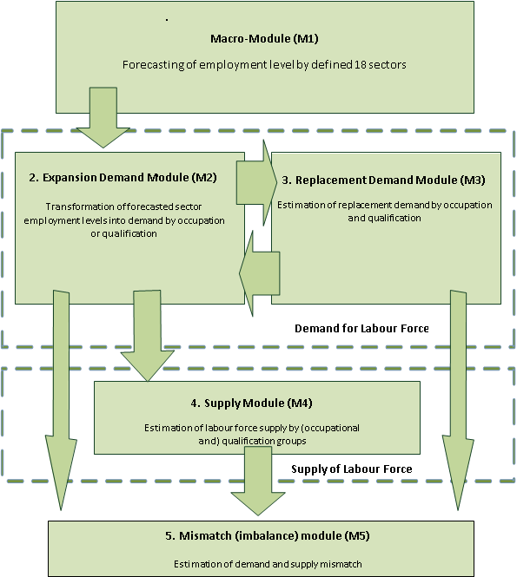
Structure of the model
M1: Macro-Module
M2: Expansion Demand
M3: Replacement Demand
M4: Supply Module
M5: Mismatch & Imbalances

Slide 5
Main data sources
Macroeconomic forecast of economic development by sectors;
Microdata of the labor force survey;
Microdata of the population survey on labor migration;
Official demographic forecast;
Other sources, for instance, Google trends data on job search abroad

Slide 6
The Labor Force and Labor Migration Surveys
The Labor Force Survey is a main source of information on composition and structure of the labor force, employment, unemployment, economical inactivity etc. From 1999 the LFS is conducted on a permanent basis: in 1999-2003 – quarterly, and from January 2004 it is conducted on a monthly basis. The LFS methodology is consistent with ILO concepts and definitions. The survey is conducted by interviewing non-institutional households covered by the sample which is created on base of the stratified multi-stage probability sampling procedure. In each household sampled in the survey, demographic information and specific information on the economic activity of household members aged 15-70 is collected for the week completed before the surveyed week. From 2004 onwards, 11.1 thousand households representing all regions of Ukraine are sampled for monthly surveys. Both households and their members aged 15-70 are the LFS survey units. The LFS findings are indicator estimates, for this reason when decision is made regarding areas of their application one should take into account the extent to which this data is reliable.
The Labor Migration Survey was organised as a module od the LFS. 26.7 thousand households were selected for the survey of labor migration, of which 21.7 thousand were polled. The level of participation of households in the examination of labor migration in Ukraine as a whole was 81.3%, in urban settlements - 74.5%, and 90, 5% - in rural areas. As household members 40,500 persons aged 15-70 years were interviewed according to the survey program. The reliability level of number of migrant estimates was from CV about 8% for the West region to CV about 25% for the North and East regions.

Slide 7
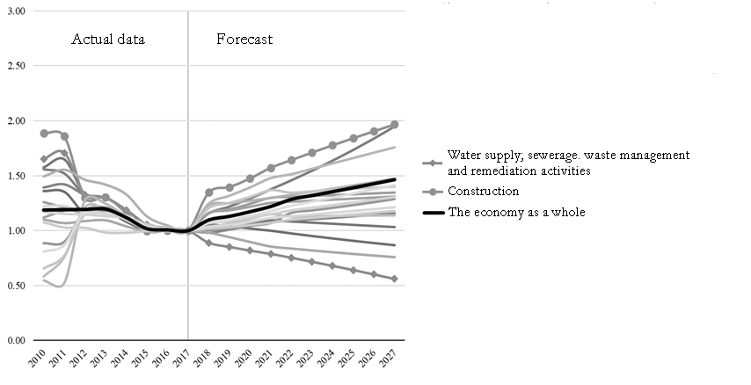
Change in employment by sectors, 2010 - 2027 (2017 = 1.0)

Slide 8
Sex and age structure of employed in occupation Professionals in the field of computing systems

Slide 9
Sex and age structure of employed in occupation The simplest occupations in agriculture

Slide 10
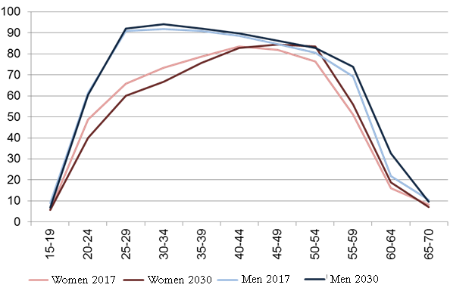
Forecast of economic activity of the population by sex and age groups

Slide 11
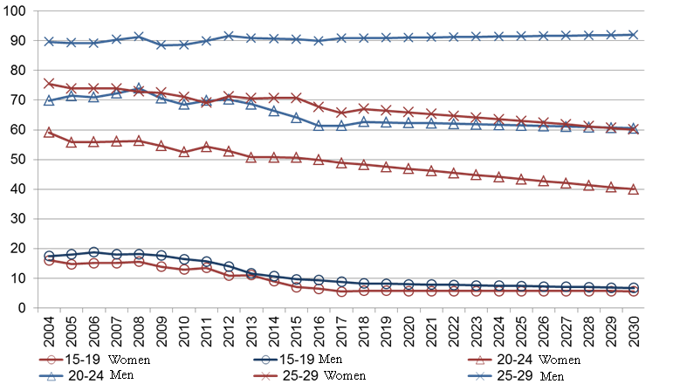
Economic activity of population by age and sex groups (younger age groups)

Slide 12
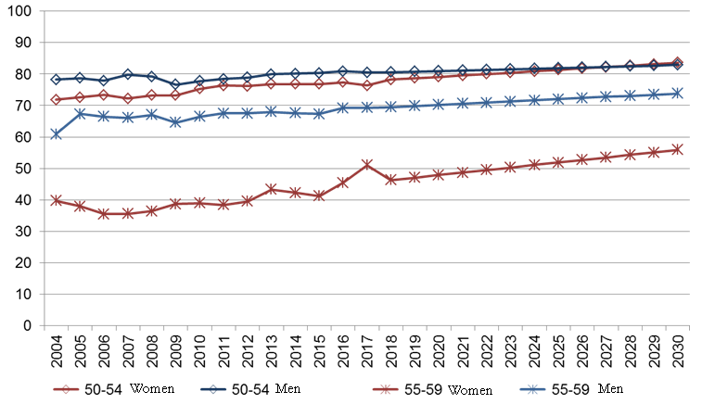
Economic activity of population by age and sex groups (older age groups)

Slide 13
Labor migrants by occupational groups, by gender and by type of locality prior to traveling abroad, 2015-2017
 | Total | Female |  |  |  | Male | Urban area | Rural area
Number of migrant workers who worked abroad, total (thousands) | 1275,6 | 381,2 |  |  |  | 894,4 | 655,0 | 620,6
by qualification group, %
Clerical Support Workers | 9,1 |  | 6,0 |  | 10,5 |  | 12,8 | 5,1
Services and Sales Workers | 14,3 |  | 33,1 |  | 6,3 |  | 14,9 | 13,6
Skilled Agricultural, Forestry and Fishery Workers | 1,7 |  | 0,4 |  | 2,3 |  | 1,6 | 1,9
Craft and Related Trades Workers | 25,9 |  | 2,3 |  | 35,8 |  | 29,4 | 22,2
Plant and Machine Operators and Assemblers | 7,4 |  | 2,9 |  | 9,3 |  | 8,0 | 6,7
Elementary Occupations | 41,6 |  | 55,3 |  | 35,8 |  | 33,3 | 50,5

Slide 14
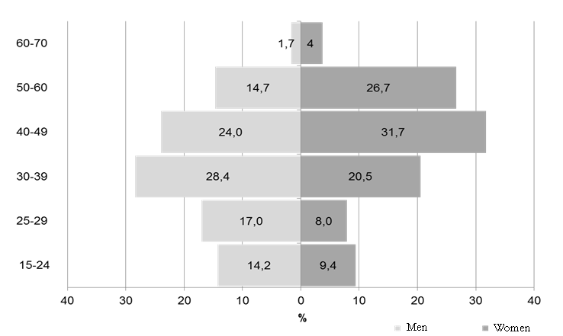
Sex and age structure of external labor migrants
Total number of migrants: 1 303 334,
Women: 385 799, men: 917 535
На основі даних дослідження «Зовнішня трудова міграція населення України»

Slide 15
Sex and age structure of labor migrants
by professional groups (before traveling abroad)
Skilled workers with instruments
Simplest occupations
На основі даних дослідження «Зовнішня трудова міграція населення України»

Slide 16
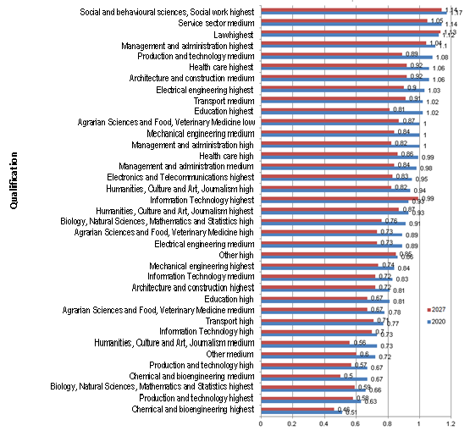
Supply and demand ratios 2020 - 2027

Slide 17
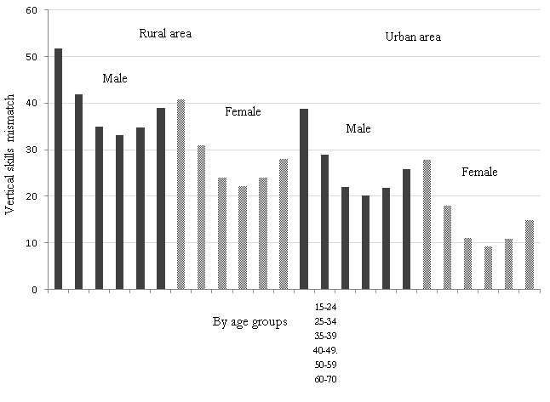
Index of the vertical skills mismatch (over-qualification rate)
by sex, age group and type of locality

Slide 18
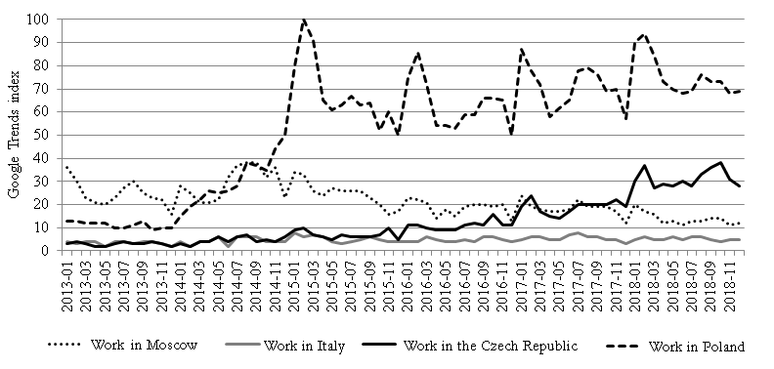
Vacancies for labor migrants

Slide 19
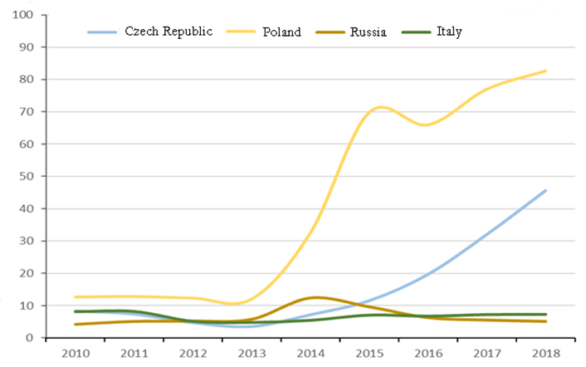
Relative frequency of job search requests (Google Trends)

Slide 20
Some remarks
The results obtained on base of realised estimates show that the replacement demand in Ukraine by certain professional groups can be substantially increased through labor migration. In particular, the high level of the replacement demand for workers in the simplest occupations is intensified by external labor migration of representatives of these occupations, which make up an average of almost 42% of migrants.
Assuming that there are about 2.7 million migrants in Ukraine, and this number has been stable over the last few years, according to their age structure, the replacement of labor migrants requires about 26.4 thousand people per year, which makes about 0.16% of all employed in 2017. For those employed in the simplest professions, the annual demand for replacement due to labor migration is about 11 thousand people or 0.35% of all employed in this professional group in 2017. Thus, according to estimates, the replacement demand due to labor migration is on average more than 12% of the total replacement demand.

Slide 21
Conclusions
Taking into account the the importance of the forecast of labor demand and, in particular, the replacement demandt for Ukrainian LM the actual directions of research in this area are determined by the problems that need to be solved. One of the main of these problems is the detailing of forecasts for occupations and qualifications. Precisely detailed forecasts can provide guidance for the system of vocational education on the direction and scope of training, and for young people and people who want or need to change the occupation, the most promising in terms of employment opportunities for occupations.
Ensuring the detail of forecasts of labor demand is possible, first of all, based on the use of more relevant and complete set of information. Thus, the availability of labor force and labor migration survey data, other surveys and registers at the micro level, that is, at the level of individuals has a critical value. Such data, even depersonified, enables us to investigate relevant processes using more sophisticated approaches, including pseudo-cohort methods and stock-flow simulations for one-year sex-age groups and / or for significantly more advanced vocational qualifications.
It is important for Ukraine to ensure the regular conduct of a number of special studies in the labor market. First of all, we are talking about studies of labor migration, which should be carried out by state statistics agencies more than once every five years usinf more relevant and more effective sampling drsign, the study of transitive processes and studies of educational and professional trajectories of youth.
A very important area of ​​research is the development and implementation of tools - methodologies, software tools, instructions, as well as the formation of skills for using the results of the forecast assessment of labor demand in public administration.

Slide 22
References
Analytical report on occupational and skills forecasting in Ukraine. Final version, Kyiv, 2017.
Bosworth D., Wilson R Forecasting skill supply and demand in Europe to 2020: A Pseudo-cohort/Stock-flow Model of European Qualifications Supply, ROA, 2012. – 41 p.
Bosworth D., Li Y., Wilson R. Modelling and forecasting the demand for occupations and qualifications. Technical Report, ROA, 2011. – 55 p.
Developing skills foresights, scenarios and forecasts // European Centre for the Development of Vocational Training / International Labor Office. – 2016.- 220 p.
Developing skills foresights, scenarios and forecasts // European Centre for the Development of Vocational Training / International Labor Office. – 2016.- 220 p.
Економічна активність населення України 2017: Стат.збірник / Державна служба статистики України, Київ, 2018. – 205 с.
Зовнішня трудова міграція населення (за результатами модульного вибіркового обстеження): стат. бюл. / Державна служба статистики України. Київ, 2017. 36 с.
Українське суспільство: міграційний вимір: нац. доповідь / Інститут демографії та соціальних досліджень імені М. В. Птухи НАН України. Київ, 2018. 396 с.

Slide 23
Thanks for your attention!

