Slide 1
An overview of population size estimation where linking registers results in incomplete covariates, with applications to mode of transport of serious road casualties and size of Maori population
Peter G.M. van der Heijden
Department of Methodology and Statistics, Utrecht University
and S3RI, University of Southampton
Work with Cruyff, Gerritse (UU), Bakker (SN), Whittaker (UoL), Paul Smith (Soton)
Zwane (PhD student, now University of Swasiland)

Slide 2
Outline
Capture-recapture two-list case
Capture-recapture three-list case
Including categorical covariates
Graphical models and collapsibility properties
Covariates not observed in every list
Examples where covariate in A measures identical concept as covariate in B
Future research

Slide 3
Outline
Capture-recapture two-list case
Capture-recapture three-list case
Including categorical covariates
Graphical models and collapsibility properties
Covariates not observed in every list
Examples where covariate in A measures identical concept as covariate in B
Future research

Slide 4
List 2
n11 | n10
n01 | ?
List 1
Assumptions:
Population is closed.
No matching problems.
Capture probabilities homogeneous over individuals.
Probability of being in list 1 independent of probability
of being in list 2
Introductions: Bishop et al (1975); IWGDMF (1995)

Slide 5
Estimation of unobserved part of population
with identifying restrictions
Software: any program for loglinear modelling
Cell (i,j)=(0,0) is structurally zero

Slide 6
Example 1
Data: population with Afghan, Iranian or Iraqi nationality that stays in the Netherlands, either with or without legitimate documents.
Preparation of virtual census 2011 in the Netherlands
Netherlands has population register, here:
Estimate groups missed by the population register

Slide 7
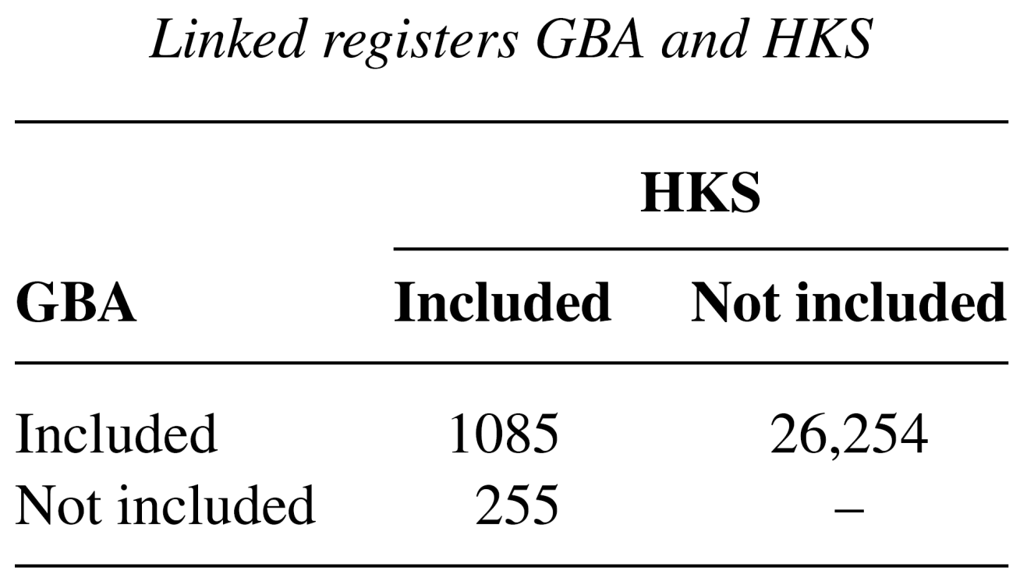
GBA: official register
HKS: police register with suspects
Number missed 26,254 * 255 / 1,085 = 6,170.3

Slide 8
Usual assumptions
Being in GBA statistically independent from being in HKS
Inclusion probabilities homogeneous in at least one register
Independence assumption difficult to verify
Undocumented aliens try to stay out of hand of police -> lower probability to get caught
Undocumented aliens need goods to live -> higher probability to get caught

Slide 9
Solutions to violations
Include covariates, using loglinear models
Include third register
Latent variable model (at least three registers needed)

Slide 10
Outline
Capture-recapture two-list case
Capture-recapture three-list case
Including categorical covariates
Graphical models and collapsibility properties
Covariates not observed in every list
Examples where covariate in A measures identical concept as covariate in B
Future research

Slide 11
Three list case
Dependence between registrations can be result from
Heterogeneity of capture probabilities: ‘apparent dependence’
(sum of two matrices where probabilities are independent
leads in general to dependent matrix).
-‘True’ dependence
More than two registrations: dependence between registrations can be taken into account in log-linear model.

Slide 12
Estimation of unobserved part of population
with identifying restrictions
Assumptions: three-factor interaction is zero,
Interactions are constant over individuals
Software: any program for loglinear modelling
Cell (i,j,k)=(0,0,0) is structurally zero

Slide 13
Example 2: Reported cases of drug injectors, Glasgow, 1989
(Frischer and Leyland, Lancet, 1992)
Police | HIV test | Treatment | Count
0 | 0 | 1 | 831
0 | 1 | 0 | 389
0 | 1 | 1 | 109
1 | 0 | 0 | 366
1 | 0 | 1 | 23
1 | 1 | 0 | 15
1 | 1 | 1 | 5
Observed 1738

Slide 14
Model | X2-test | df | p
P,H,T | 53.3 | 3 | 0.0
PH,T | 49.5 | 2 | 0.0
TP,H | 23.6 | 2 | 0.0
HT,P | 2.1 | 2 | 0.5
Estimated population size under HT,P: 9400 (SD 1230)

Slide 15
Example 3: Homeless in Zwolle; small n
Four locations: B for Bonjour, N for Nelbannink, H for de Herberg and P for Pannenkoekendijk, n = 134
Model | G2 | par | AIC | N0 | N | CI
PB,PN,PH,BN,BH,NH | 5.2 | 11 | 27.2 | 26.7 | 160.7 | 132-343
PB,PN,BN,BH,NH | 5.3 | 10 | 25.3 | 32.5 | 166.5 | 136-306
PN,BN,BH,NH | 6.5 | 9 | 24.5 | 21.0 | 155.0 | 132-198
PN,BH,NH | 8.9 | 8 | 24.9 | 10.3 | 144.3 | 133-157
BH,NH | 11.4 | 7 | 25.4 | 9.4 | 143.4 | 131-153

Slide 16
Outline
Capture-recapture two-list case
Capture-recapture three-list case
Including categorical covariates
Graphical models and collapsibility properties
Covariates not observed in every list
Examples where covariate in A measures identical concept as covariate in B
Future research

Slide 17
No covariates
Covariate X indexed by x
Also denoted as [IX][JX], more restrictive models possible
In [IX][JX] inclusion probabilities for I and J vary
by levels of X

Slide 18
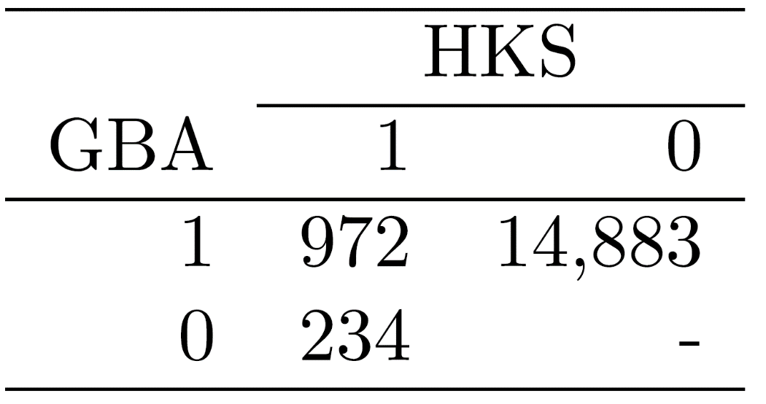
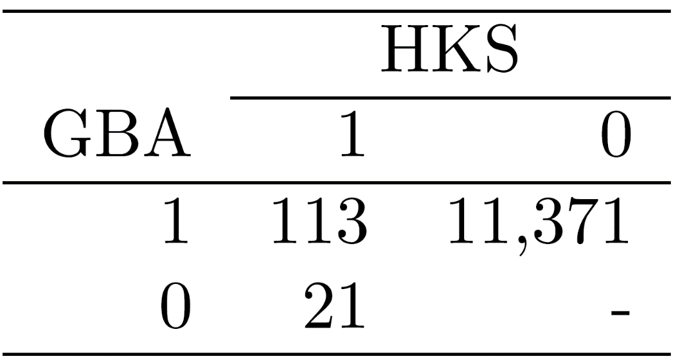
Example 1 revisited
Males on the left, females on the right
Missed for males: 3,584; missed for females 2,113
Together 5,696 missed

Slide 19
Example 4:
Prevalence of diabetes in a town of northern Italy.
Four registrations:
Diabetic clinic, family physician.
Hospital discharge.
Insulin and oral hypo glycerin.
Reagent strips and insulin syringes.
Covariate: treatment
Diet.
Hypoglycemic agents.
Insulin.

Slide 20
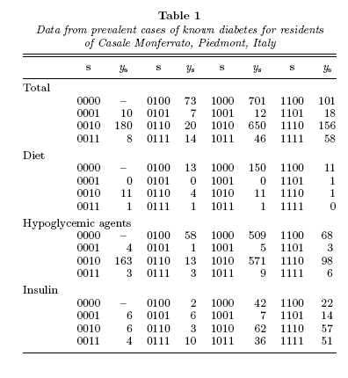

Slide 21
Models ignoring observed heterogeneity
Model | df | LRX
S1,S2,S3,S4 | 10 | 215
+S2S4 | 9 | 96
+S3S4 | 8 | 56
+S1S3 | 7 | 22
+S2S3 | 6 | 14
+S1S2 | 5 | 8

Slide 22
Models including observed heterogeneity
Model | df | LRX
CS1,CS2,CS3,CS4 | 30 | 122
+CS1S3 | 27 | 84
+CS2S4 | 24 | 55
+CS3S4 | 21 | 36
+CS1S4 | 18 | 26
Less dependence between lists because
observed heterogeneity is taken into account

Slide 23
Example 5: Human trafficking in the Netherlands

Slide 24
Published in Chance 2017

Slide 25
Six/five registers, depending on whether you include border police
2010-2015
Age, gender, form of exploitation and nationality
n = 8,234
STEP plus Bootstrapped distribution of Pearson chi-square

Slide 27
Final model

Slide 29
Outline
Capture-recapture two-list case
Capture-recapture three-list case
Including categorical covariates
Graphical models and collapsibility properties
Covariates not observed in every list
Examples where covariate in A measures identical concept as covariate in B
Future research

Slide 30
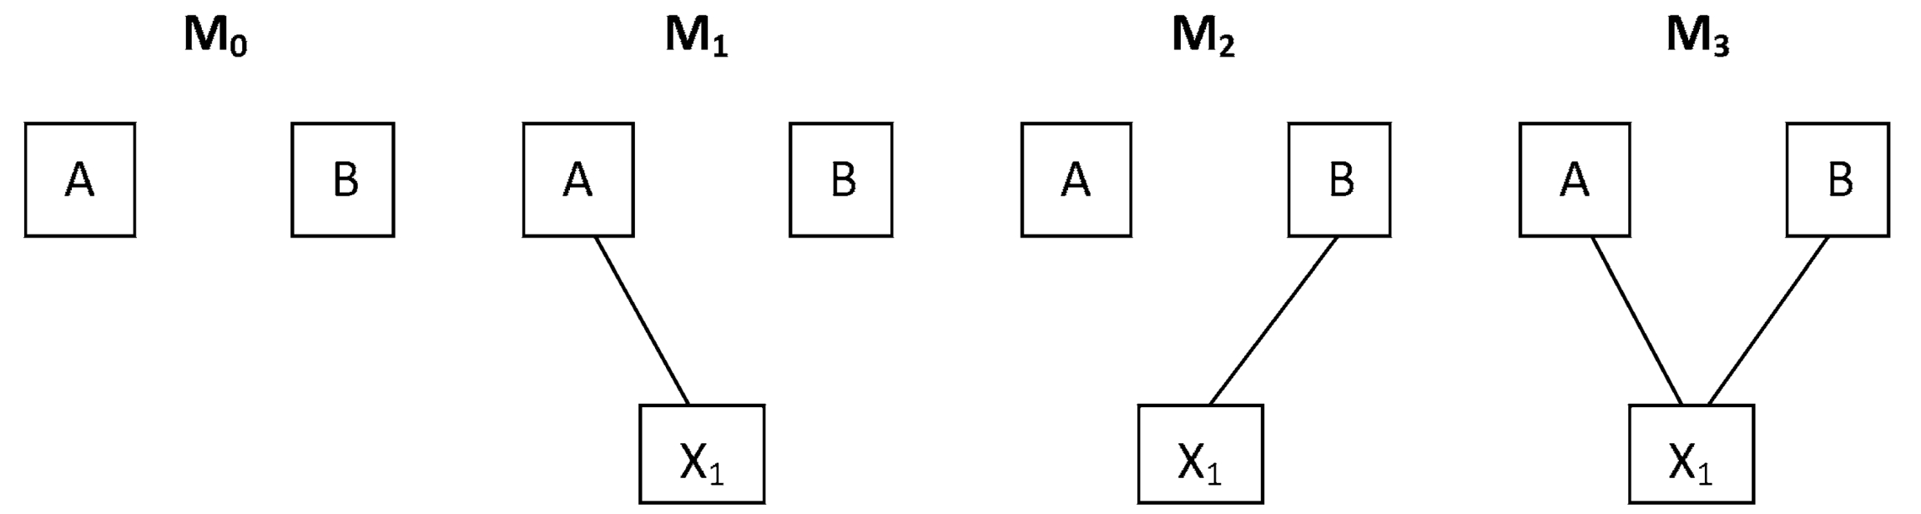
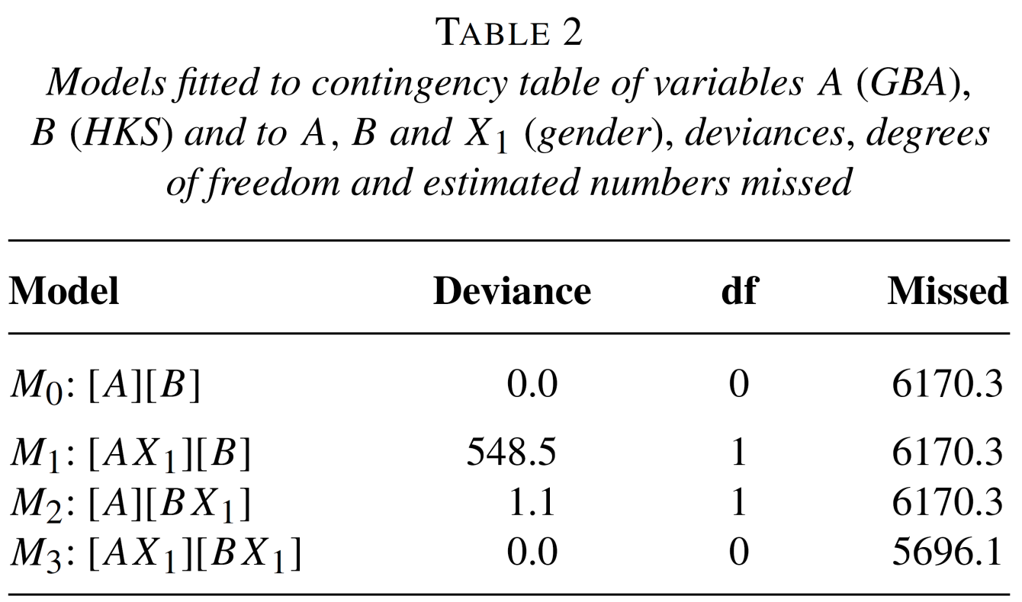

Slide 31
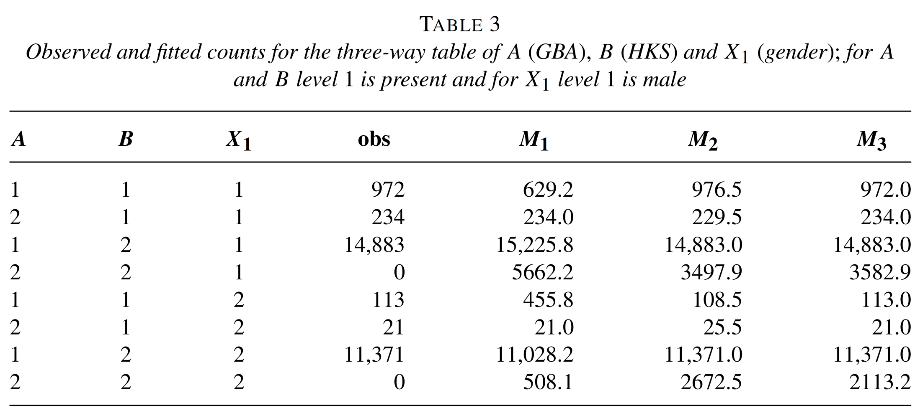
… total p.s.e. identical but estimated counts differ

Slide 32
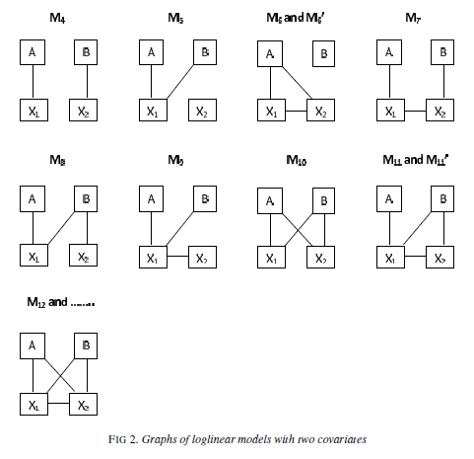
Loglinear models with two covariates
Table not collapsible over variables on short path from
A to B
(note that in last graph
A-X1-X2-B is short graph)

Slide 33
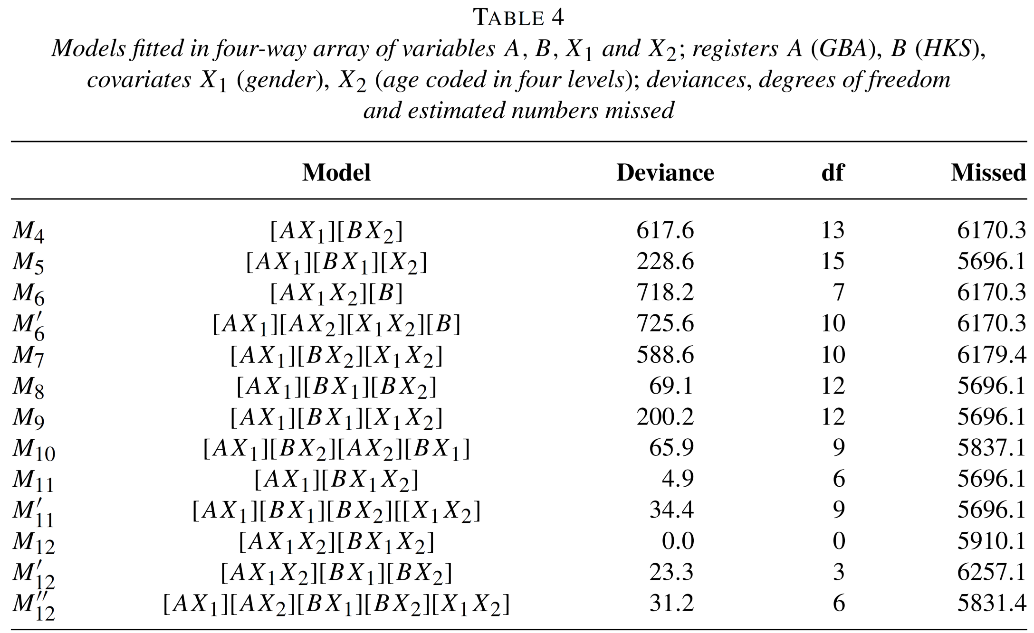

Slide 34
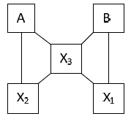
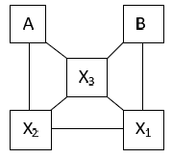
Active and passive covariates
Active: when collapsing over covariate changes p.s.e.
Passive: when collapsing does not change p.s.e.
Including p.s.e. is still useful as you are describing population in terms of these variables
X1 and X2 not active
X1 and X2 active

Slide 35
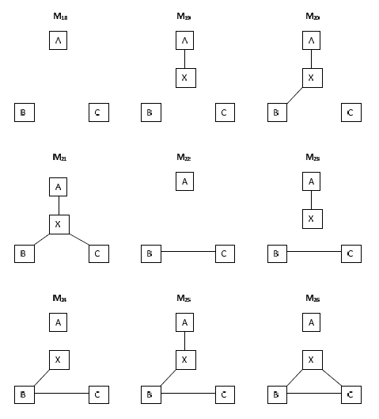
Three registers, one covariate

Slide 36
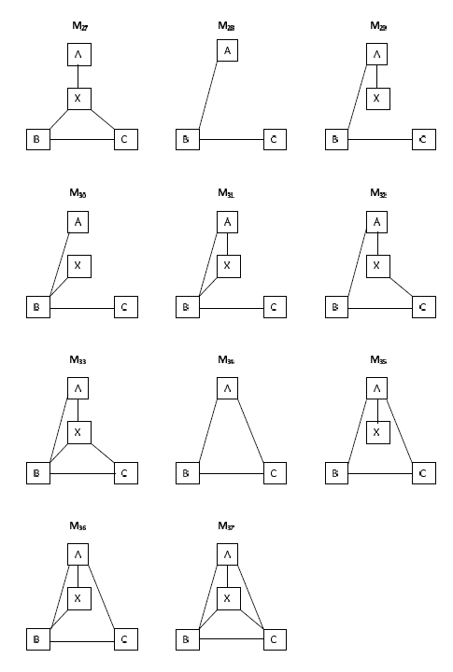

Slide 37
Outline
Capture-recapture two-list case
Capture-recapture three-list case
Including categorical covariates
Graphical models and collapsibility properties
Covariates not observed in every list, with some properties
Examples where covariate in A measures identical concept as covariate in B
Future research

Slide 38
Typical in official statistics
Linking registers
Two missing data problems:
Missing covariates
Missed individuals

Slide 39
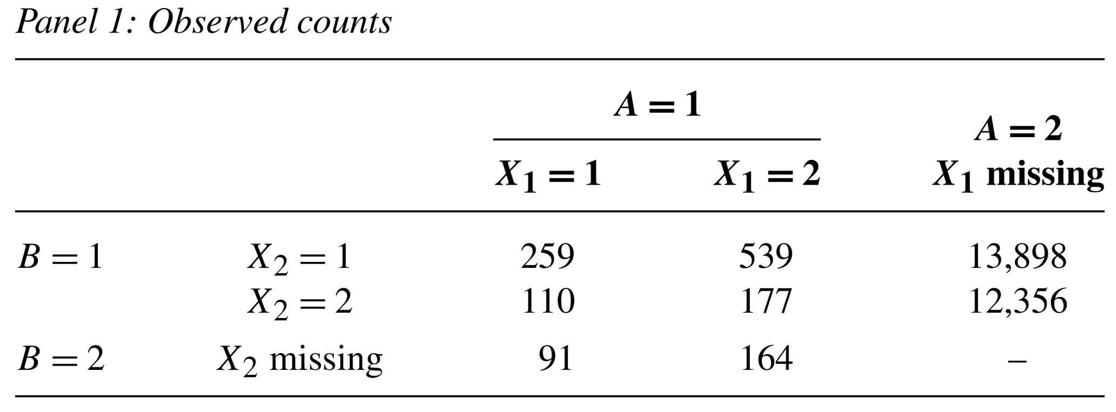
Example 1 revisited:
X1 is only in A and X2 is only in B
when observation is not in A, then X1 is missing,
when observation is not in B, then X2 is missing

Slide 40
Missing data problem
Solved using EM algorithm
E-step: expectation for missing data given observed data and parameter estimates
M-step: maximization under model (here: loglinear model)

Slide 41
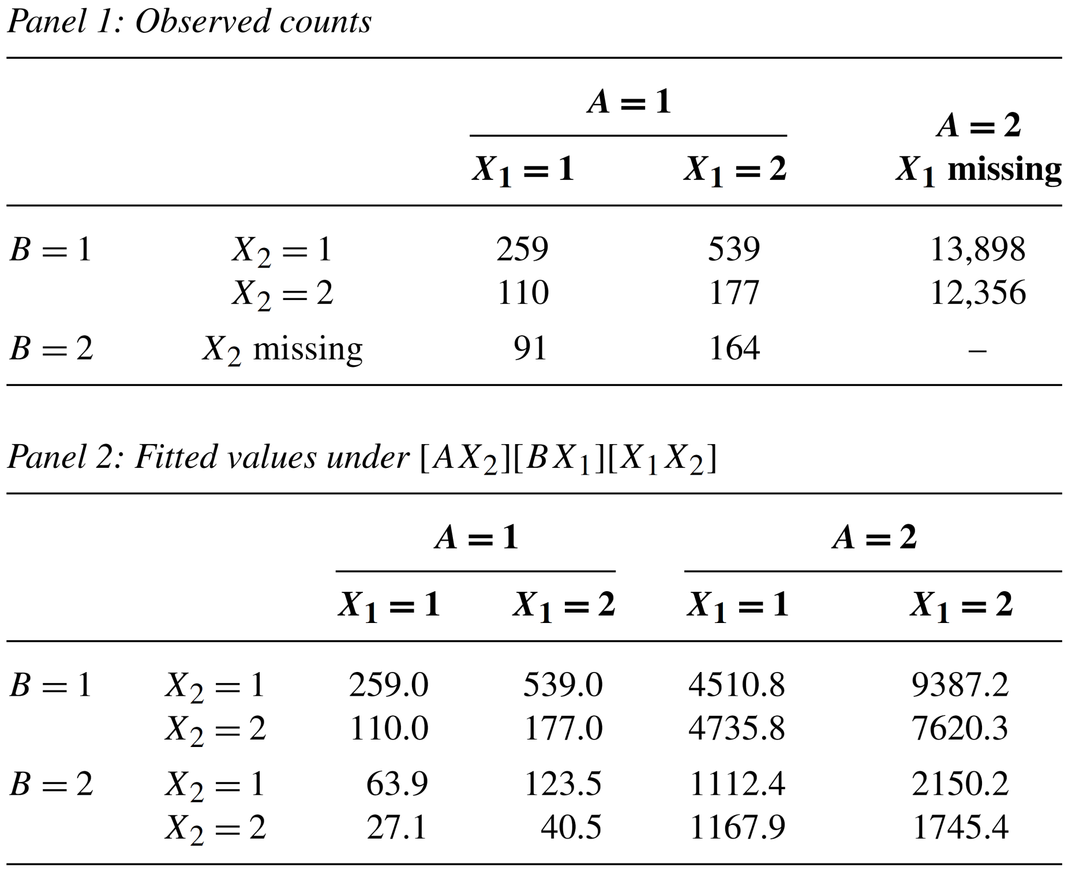

Slide 42
Property 1: maximal model
Maximal loglinear model is [AX₁][X₁X₂][X₂B], has
8 parameters for 8 counts

Slide 43
Properties 2: Collapsibility
Covariates only have impact on p.s.e.
when X₁ and X₂ are related

Slide 44
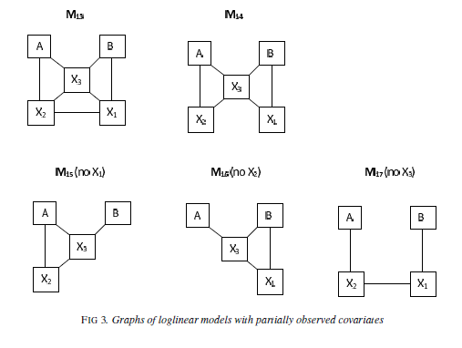
X₁ in A, X₂ in B, X₃ in A and B

Slide 45
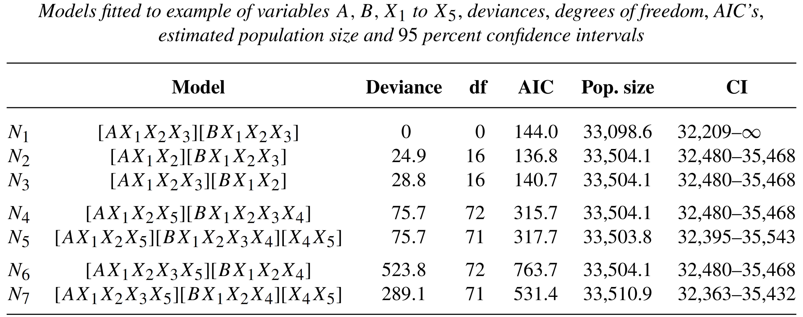
Example 1 revisited:
X1 is gender, X2 is age, X3 is nationality,
X4 is marital status (only in A: GBA),
X5 is police region (only in B: HKS)

Slide 46
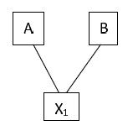
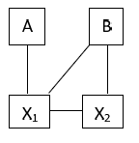
Similar to N1
Similar to N2 and N3
Similar to N4 and N6
Similar to N5 and N7

Slide 47
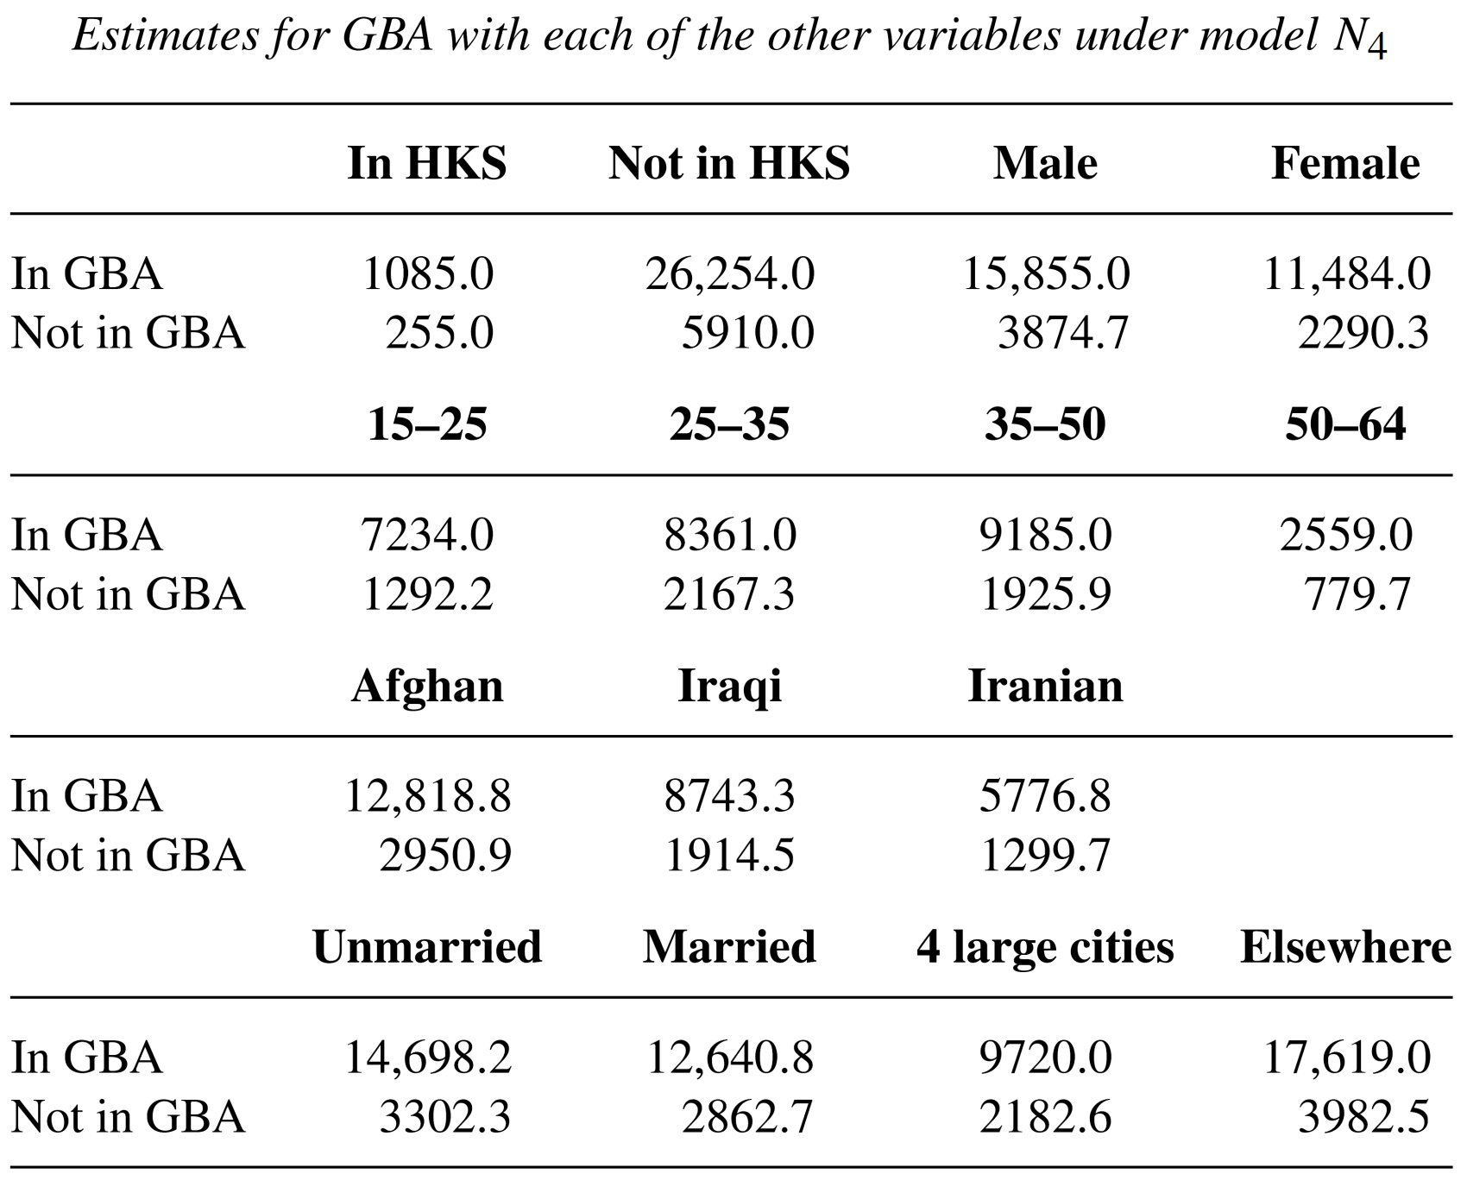

Slide 48
Property 3: power for assessing X1-X2 interaction

Slide 49
Collapsible over
X1 and X2
Not collapsible over
X1 and X2
But…….

Slide 50
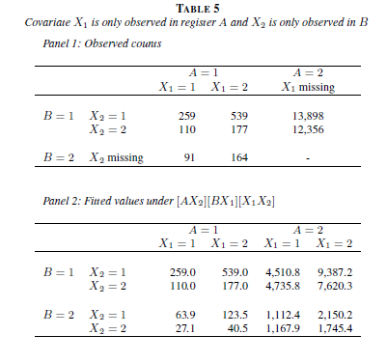
…
Not always powerful test for assessment interaction X1 – X2: preferably much overlap between A and B

Slide 51
Property 4: simulation study where EM is compared with ignoring covariates shows that EM has better point estimates but larger variances when population size gets larger, RMSE of EM is smaller than RMSE of approach ignoring variables

Slide 52
Simulations
When odds ratio of
(i), (ii) or (iii) is 1, then
the results of EM
approach equal results
of ignoring covariates.
(i)
(ii)
(iii)

Slide 53
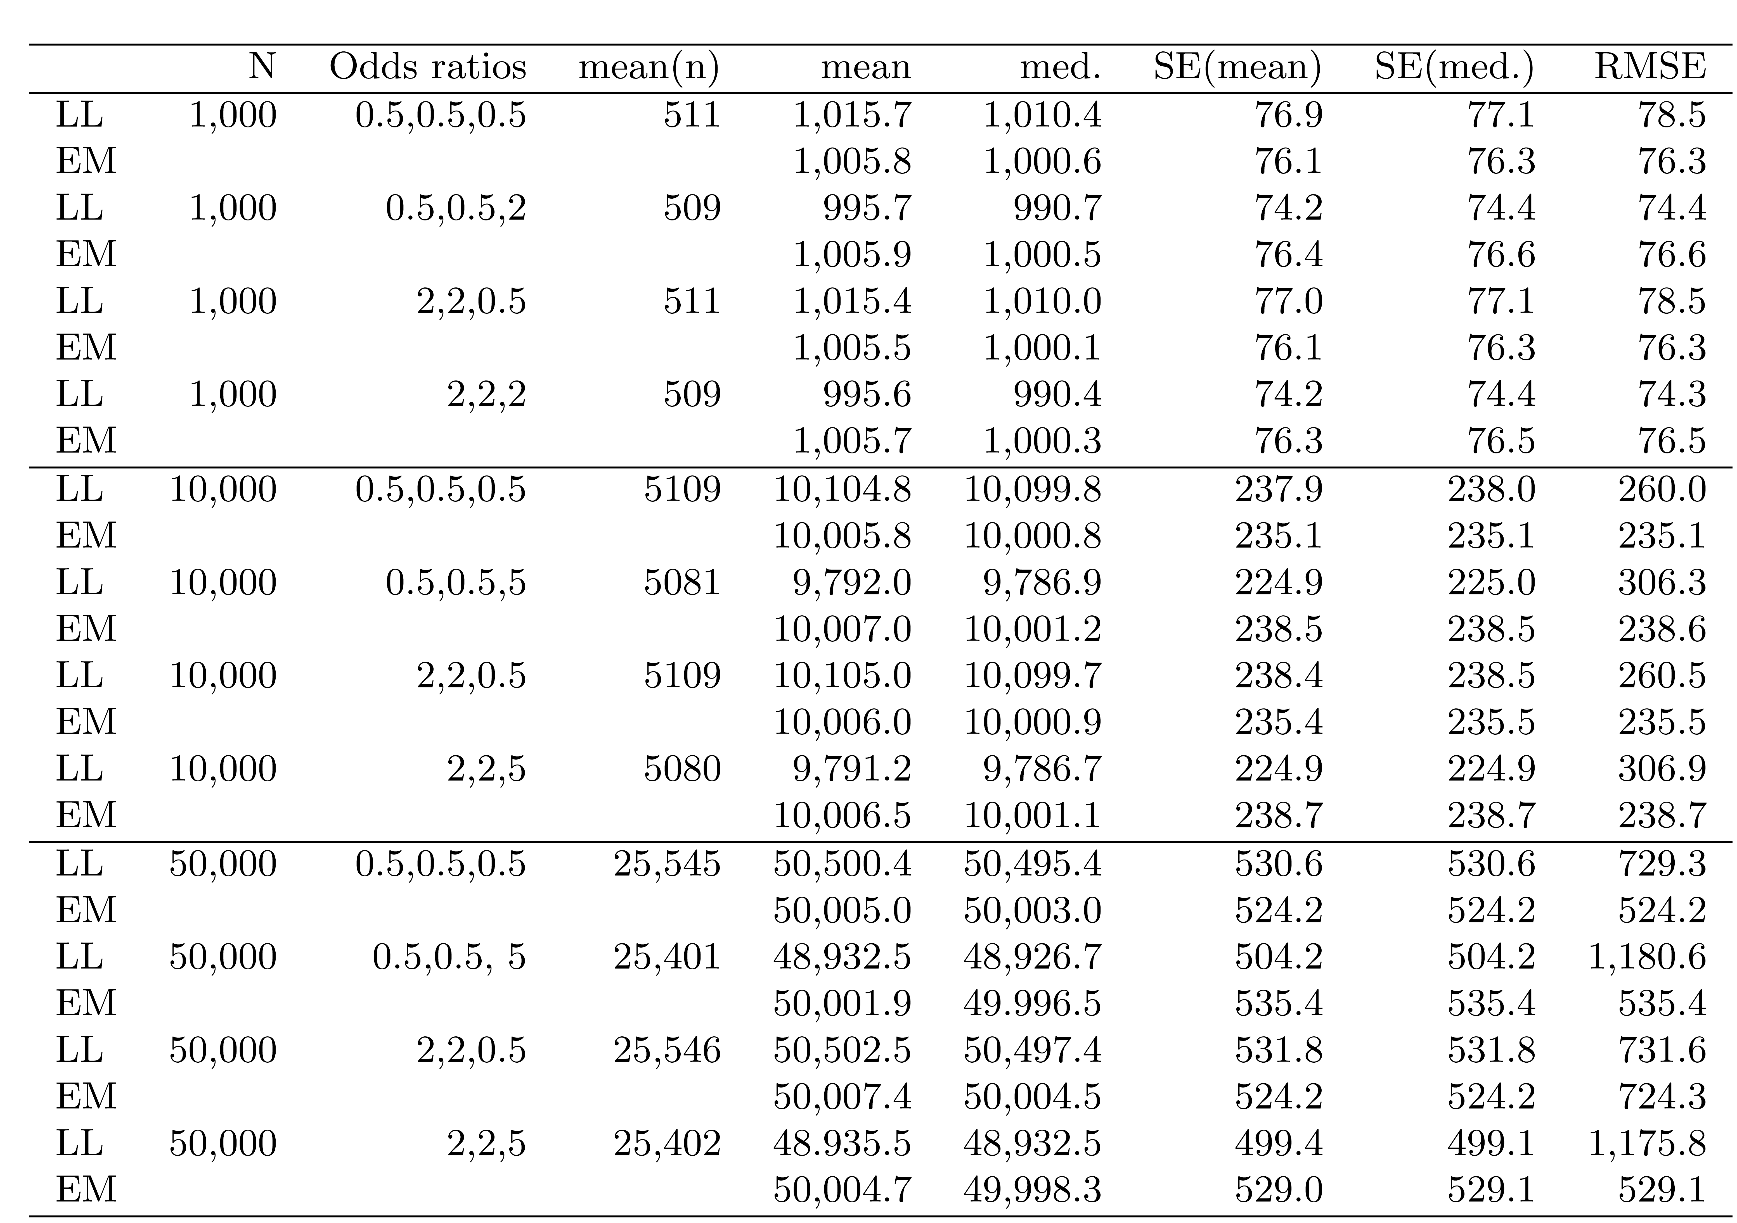
Simulation: comparison of EM and ignoring covariates (LL)

Slide 56
Property 5: sensitivity analysis of MAR assumption
Model assumes no direct link between
A and X1, and between B and X2
Simulation study: direct link between
A and B
A and X2
B and X1

Slide 58
Example 6: three lists, estimating “usual residence” in the Netherlands
Population register (PR)
Employee register (ER)
Crime suspects register (CSR)
Covariate usual residence (UR)
Application: in CSR the covariate UR is missing
Gerritse, Bakker and van der Heijden (2015). IJAOS

Slide 60
Outline
Capture-recapture two-list case
Capture-recapture three-list case
Including categorical covariates
Graphical models and collapsibility properties
Covariates not observed in every list
Example where covariate in A measures identical concept as covariate in B
Future research

Slide 61
Example 7: covariates X₁ and X₂ measure identical concept
Audit of Dutch methodology to determine the number of seriously road injuries
Two registers: police register and hospital register
Covariates X: 1. motorized vehicle involved or 2. motorized vehicle not involved
Covariate X₁ for police register as well as covariate X₂ for hospital register

Slide 62
In (a) covariate, partly missing
In (b) covariate, partly missing

Slide 63
A is police, B is hospital, year 2000
Covariate X₁ and X₂, with 1 is motorized and 2 is not motorized
We want to estimate X₁ for A=0 as we trust police data more than hospital data
We want to estimate value for empty cell (is missed by both registers)

Slide 64
Focussing on estimate according to police
Estimate X1: motorized: 7.608 + 6.214
Estimate X2: non-motorized: 354 + 2.438

Slide 65
Notice that two problems are solved:
Missing covariate problem
Missing observations problem (note that not that many accidents are missed (approximately 10 percent)

Slide 66
Data 2010: two differences with 2000
“Motorized” is split up in 6 levels:
Sitting in car
Driving motor
Driving moped
Bicycles in motorized accidents
Pedestrians in motorized accidents
Other in motorized accidents
Non motorized (bicycles and pedestrians)

Slide 67
Second difference:
in the year 2000 7.000 in Police register, 8.000 not in Pol. Reg.
In the year 2010 3.500 in Police register, 14.000 not in Pol. Reg.

Slide 68
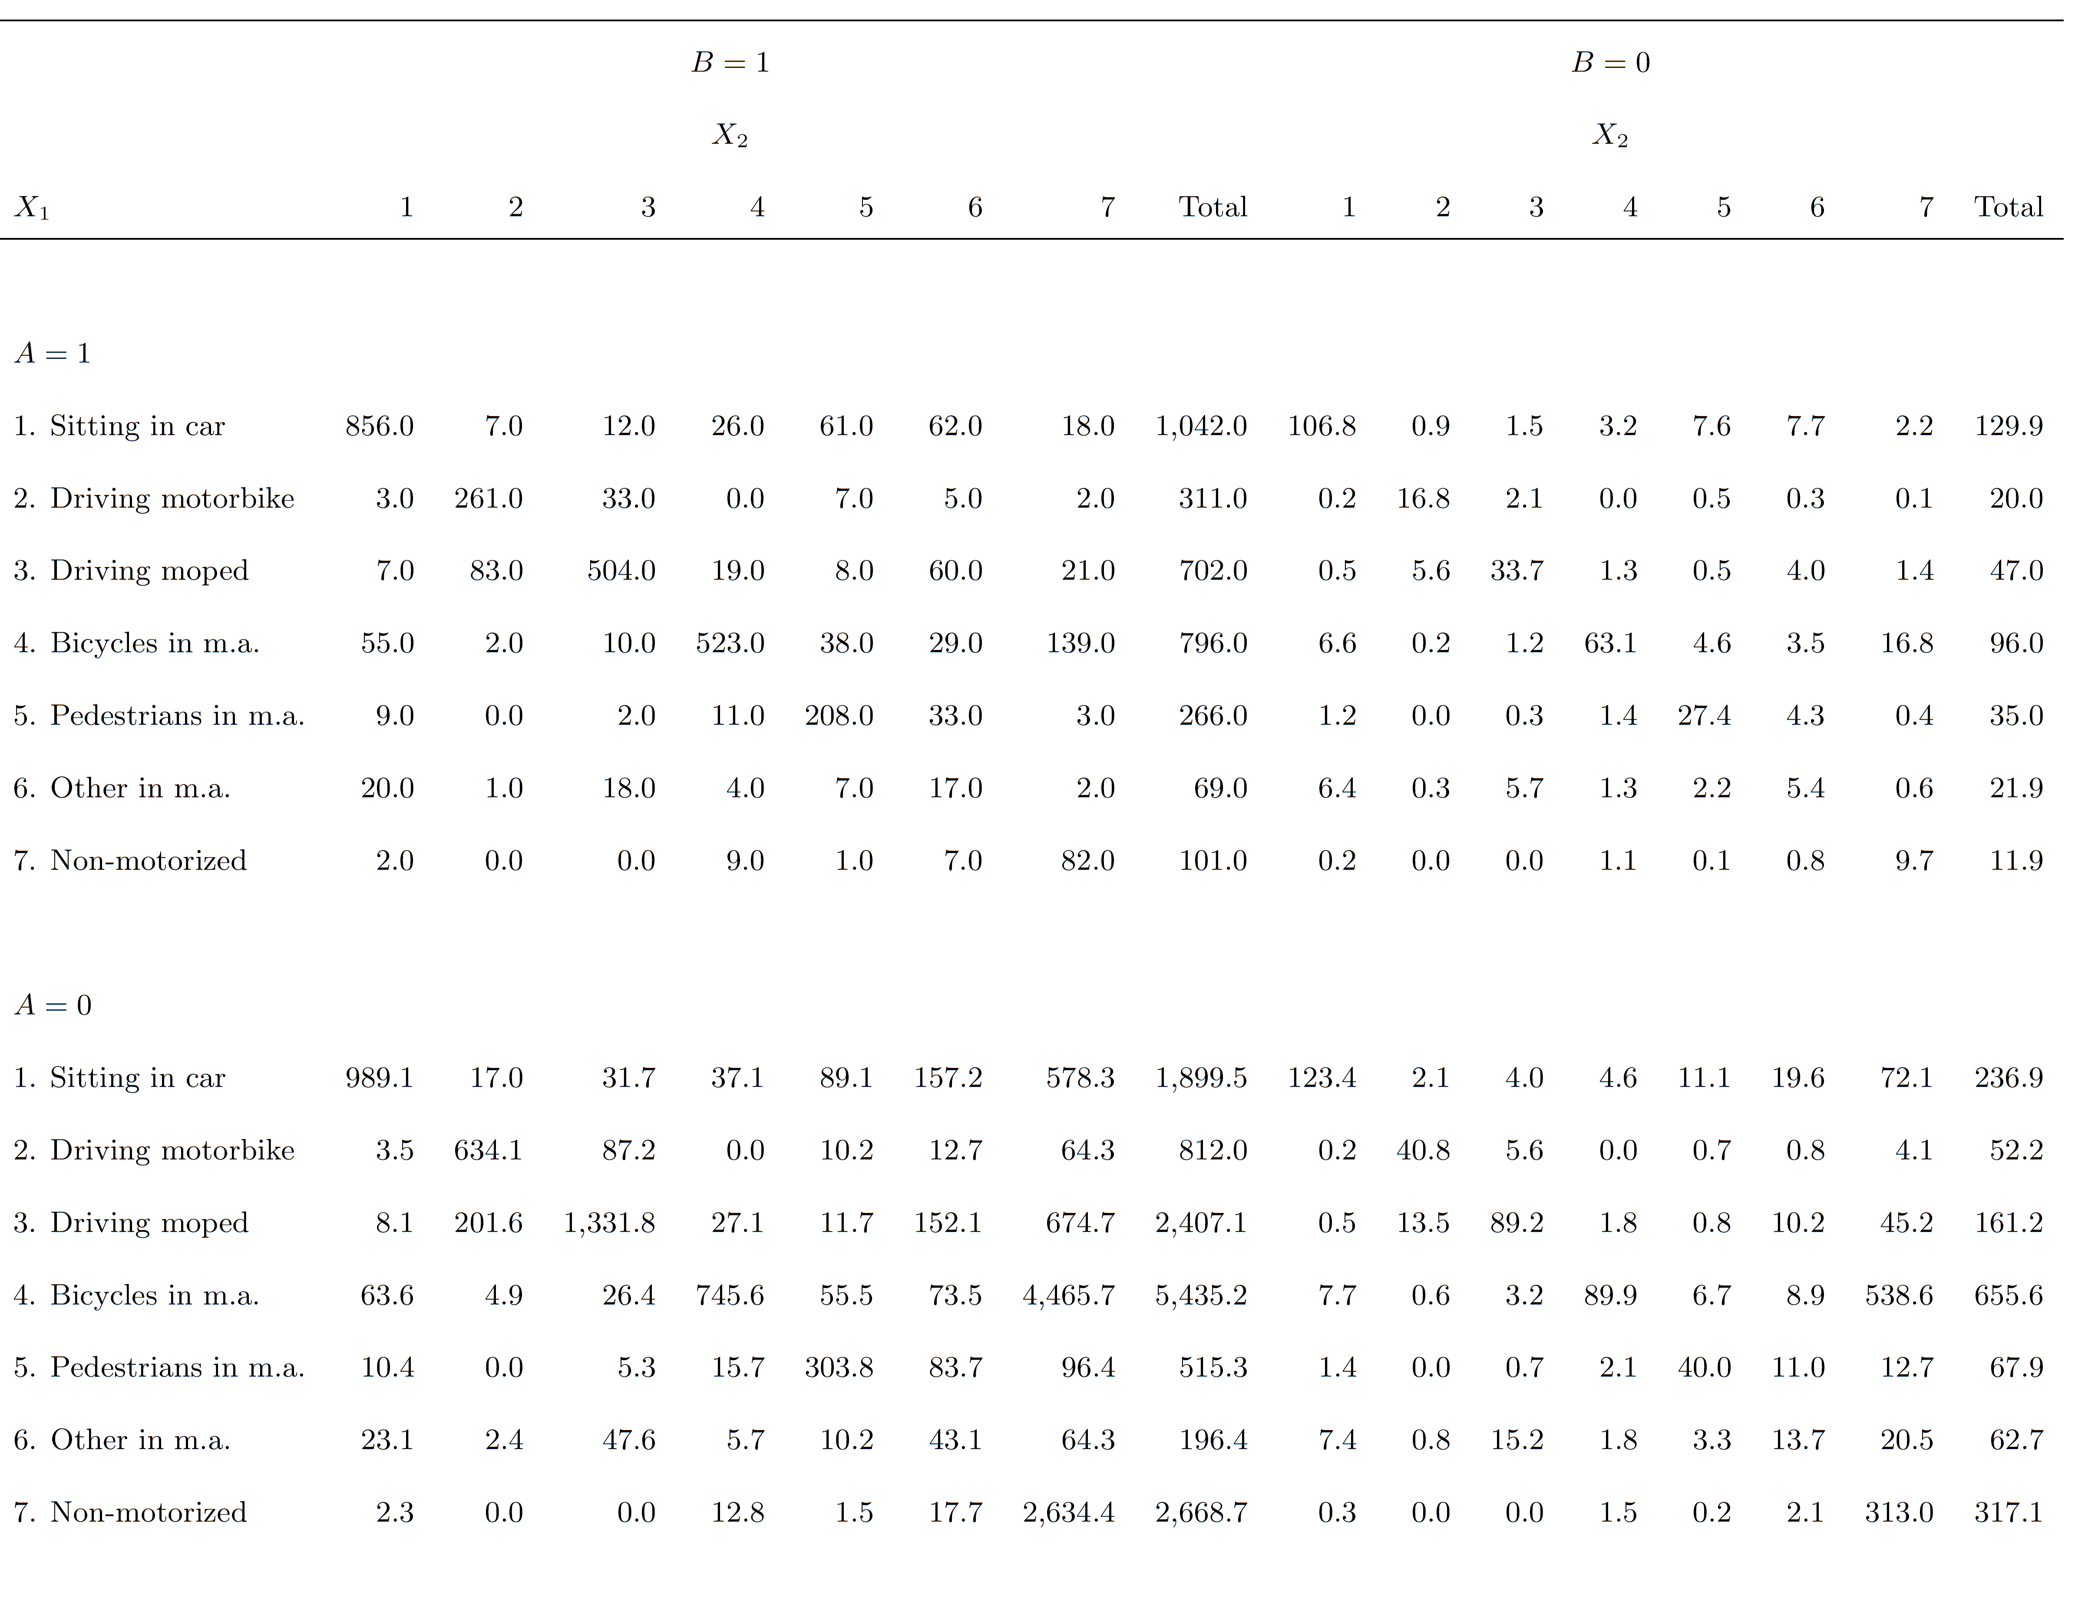

Slide 70
Example 8: estimating the size of the Maori population (work in progress)
(with Christine Bycroft and Patrick Graham, SNZ)
Extension 1: four sources
2013 Census
Department of Internal Affairs (DIA) birth registrations data
Ministry of Health (MOH) National Health Index system
Ministry of Education (MOE) tertiary education enrolment data

Slide 71
Extension 2: Additional problem:
People sometimes refuse to answer
People answer inconsistently

Slide 72
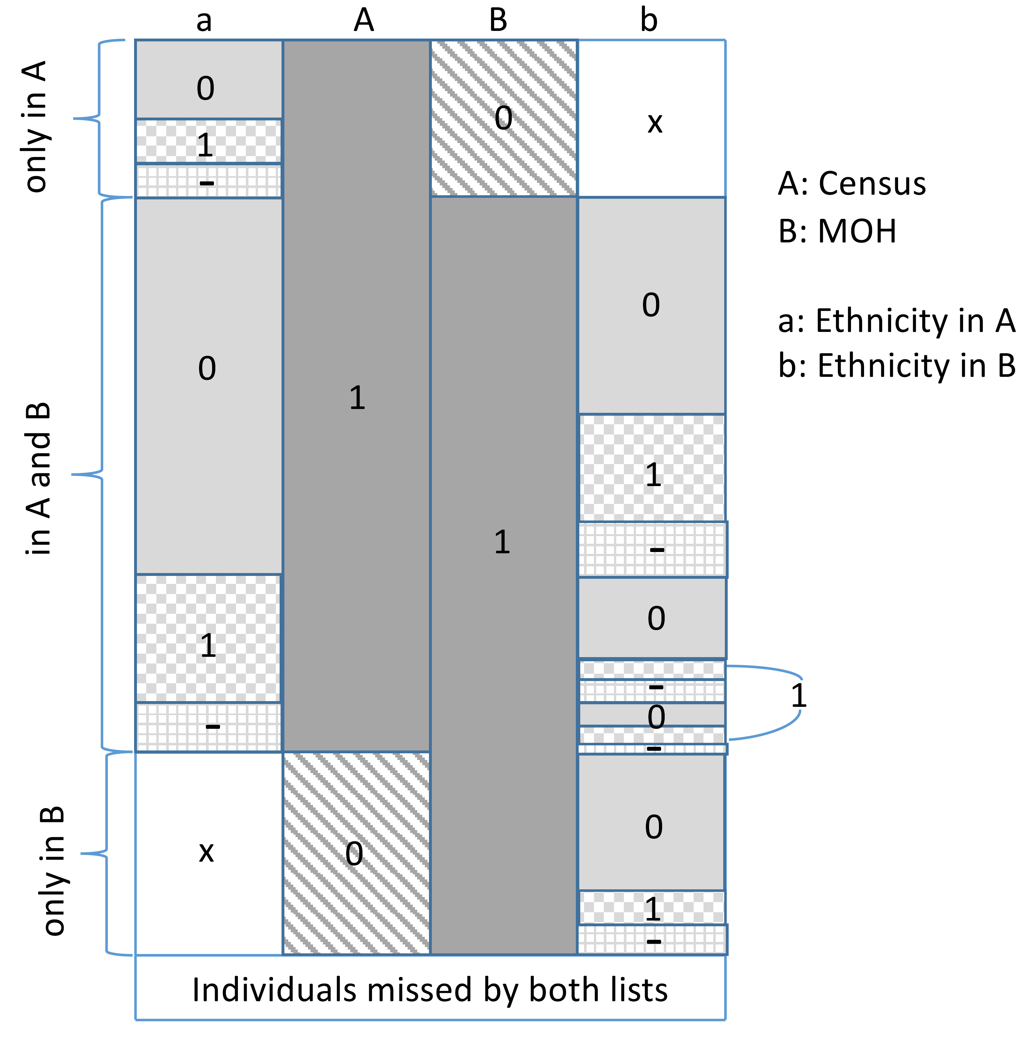

Slide 73
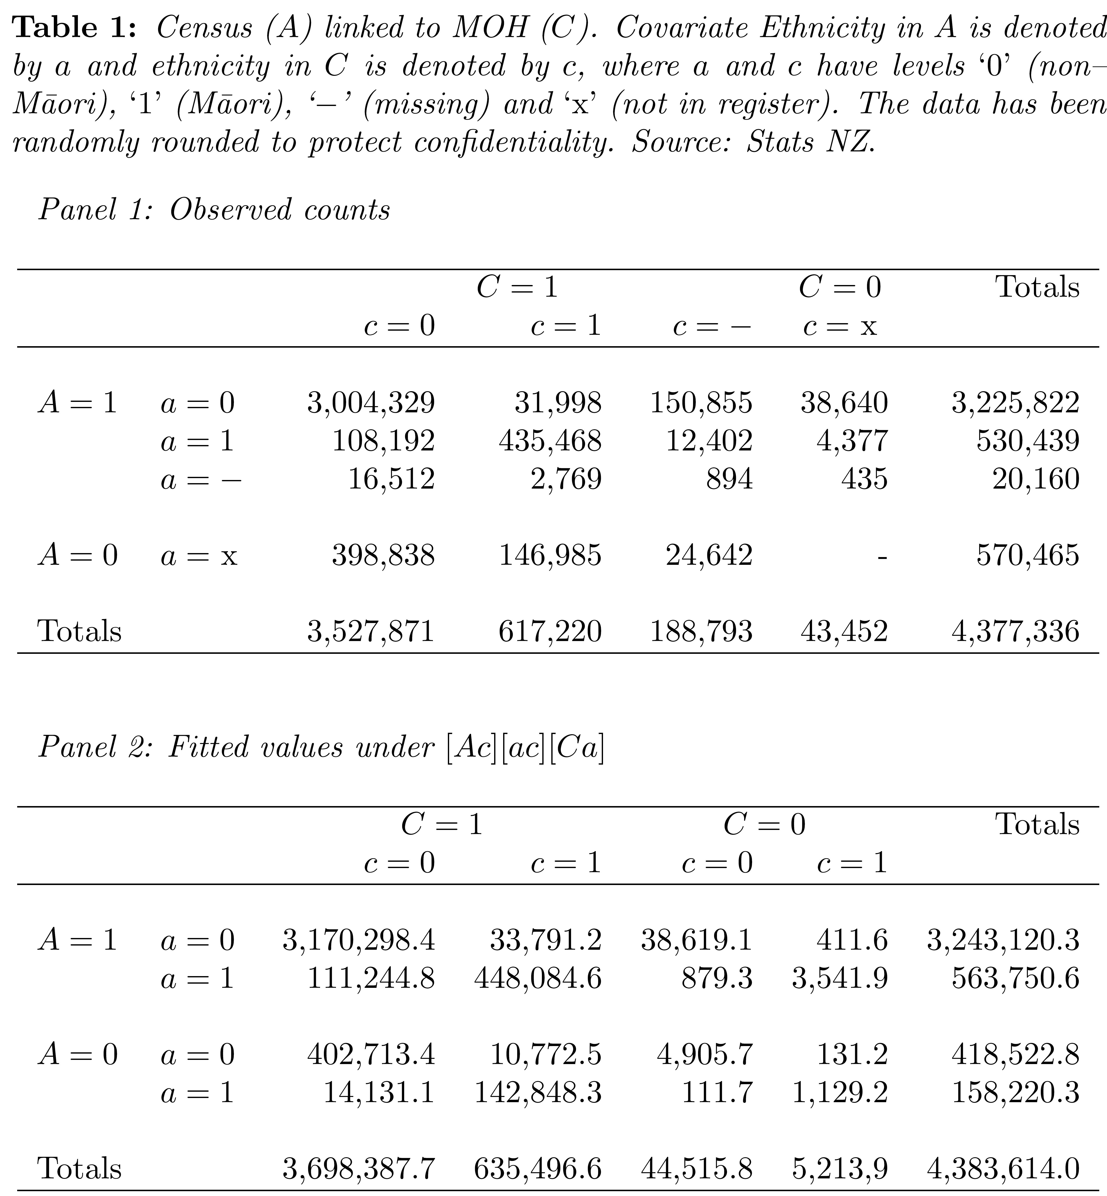
Note: item
missingness

Slide 74
Notation: Capitals A,B,C,D for being in register (0,1),
Ethnicity variables a,b,c,d with small character (non-Maori, Maori, item missing, missed by design)
Two registers: [Ab][ab][Ba] where capital for register and small for ethnicity
Three: [Abc][Bac][Cab][ABc][ACb][BCa][abc], where interest is in margin a,b,c
Note that less assumptions

Slide 75
Four registers:
[ABCd][ABDc][ACDb][BCDa][ABcd][ACbd][ADbc]
[BCad][BDac][CDab][Abcd][Bacd][Cabd][Dabc]
[abcd], interest in margin a,b,c,d

Slide 76
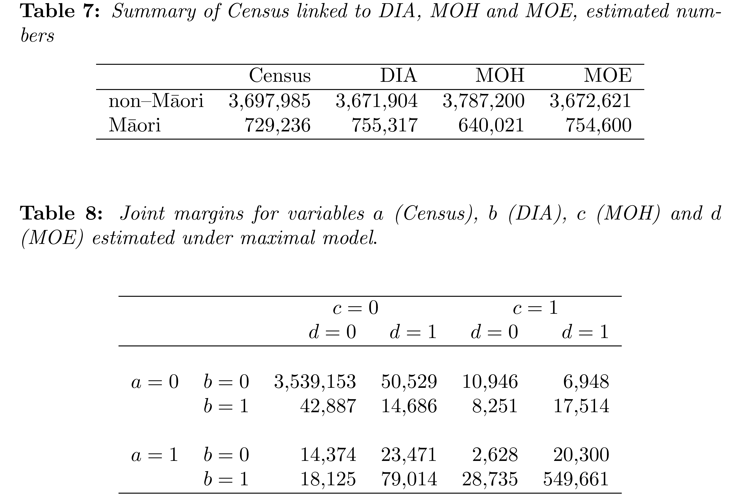

Slide 77
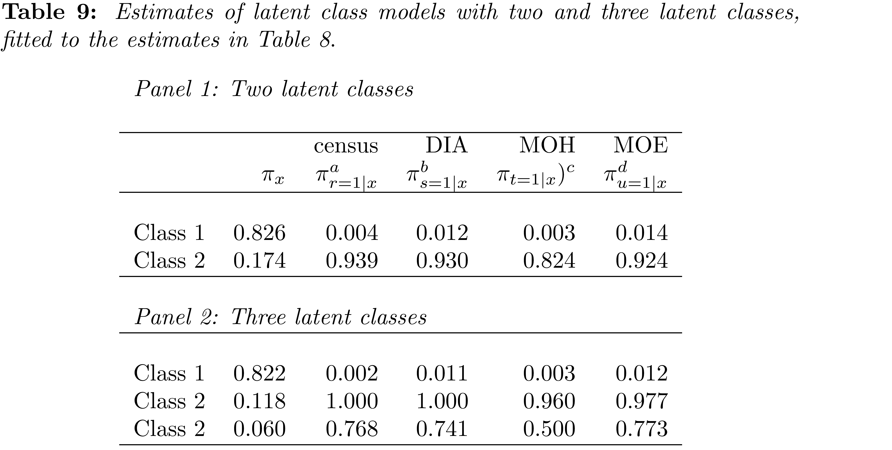
Two class model: 0.826 non-Maori with low probabilities of
answering Maori; 0.174 Maori with large measurement errors
Three class model: 1: pure non-Maori, 2: pure Maori, 3: large errors

Slide 78
Outline
Capture-recapture two-list case
Capture-recapture three-list case
Including categorical covariates
Graphical models and collapsibility properties
Covariates not observed in every list
Examples where covariate in A measures identical concept as covariate in B
Future research

Slide 79
Getting more practical experience on other data sets
- multiple sources
- multiple covariates
When stable/not stable
Many covariates, partly active, partly passive…
Continuous covariates
Sensitivity analyses

Slide 80
Current work:
Estimating N of Maori for Statistics New Zealand
Four sources A,B,C,D
Four variables a,b,c,d ethnicity
Missing covariates by design, missing by not filling in
(compare maximal model 2 sources: Ab, Ba, ab)
Maximal model Abcd, Bacd, Cabd, Dabc, Abcd, ….., abcd.

Slide 81
Some references
Zwane and van der Heijden (2007). Analyzing capture-recapture data when some variables of heterogeneous catchability are not collected or asked in all registrations. Statistics in Medicine, 26, 1069-1089.
van der Heijden, Whittaker , Cruyff, Bakker and van der Vliet (2012), People born in the Middle East but residing in the Netherlands: Invariant Population size estimates and the role of active and passive covariates. Annals of Applied Statistics, , 6, 831-852.
Gerritse, S., P.G.M. Van der Heijden and B.F.M. Bakker (2015). Sensitivity of population size estimation for violating parametric assumptions in loglinear models. Journal of official statistics. Vol. 31, No. 3, 2015, pp. 357–379, http://dx.doi.org/10.1515/JOS-2015-0022.
Gerritse, S. B.F.M. Bakker and P.G.M. van der Heijden (2015). Different methods to complete datasets used for capture-recapture estimation. Estimating the number of usual residents in the Netherlands. Statistical Journal of the IAOS, 31, 613-627.
Boehning, D., P.G.M. van der Heijden & J. Bunge (Eds.) (2017). Capture-recapture methods for the social and medical sciences. Boca Raton: CRC Press. (429 pages).
Cruyff, M., J. van Dijk & P.G.M. van der Heijden (2017). The challenge of counting victims of human trafficking. Chance, 30(3), 41-49.
Van der Heijden, Smith, Cruyff and Bakker (2018). An overview of population size estimation where linking registers results in incomplete covariates, with an application to mode of transport of serious road casualties. Journal of official statistics, 34, 239-263

Slide 82
Thank you for your attention!
Questions?

