Slide 1
Mortality & the Business Cycle: Evidence from Individual & Aggregate data
Berg, van den, GJ, Gerdtham, U-G, Hinke, von, S, Lindeboom, M, Liss-daniels, J, Sundquist, J, Sundquist, K.
ulf.gerdtham@nek.lu.se
Lund University
December 20, 2018
Örebro

Slide 2
Background
Renewed interest in economic conditions & mortality. Ruhm (2000; QJE) showed that mortality increases in good economic times
Many studies have replicated ”Ruhm” using different data, methods, different outcomes of health & health behaviors
Results are mixed: where some supports (e.g. Gerdtham & Ruhm, 2006; Neumayer, 2004; Tapia Granados, 2005, 2008) while other find the opposite (see Gerdtham & Johannesson, 2005;Economou et al., 2008)

Slide 3
Mechanisms
Similar mechanisms have been put forward for procyclical & countercyclical mortality
Risky behaviors
Opportunty cost of time
Migrants
Job-related stress

Slide 4
Macro- versus micro data
One of the diff’s btw these studies is the level of analysis: microdata or macrodata
Macrodata analysis tend to find that mortality is procyclical whereas micro-data analysis tend to find the opposite
So, are the mixed results of the relation-ship btw business cycles in economic activity & health due to the different levels of analysis in the different studies?

Slide 5
Aim of the study
Using a random sample from the entire Swe-pop we study the relationship btw transitory changes in economic conditions & individual as well as regional mortality
Main question: how accurate do models using aggregate data infer effects of the BC on mortality at the individual level, by comparing the analyses on the same underlying data, estimated at both levels

Slide 6
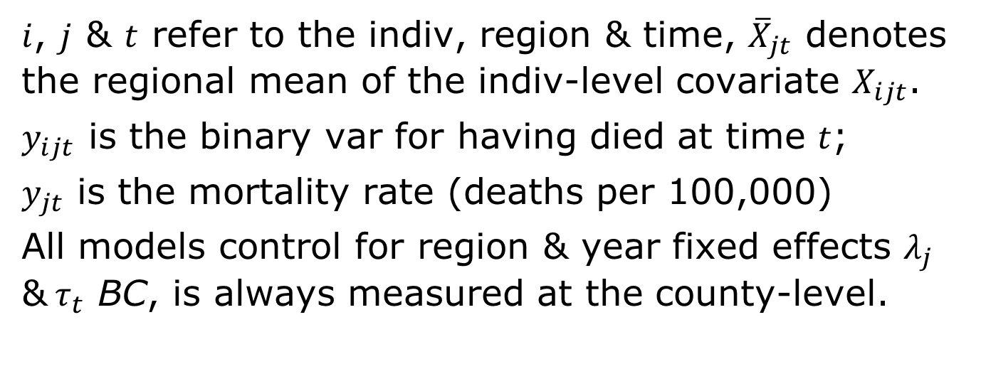
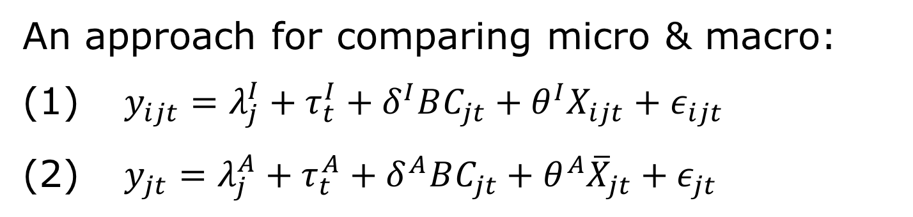
Methods
An approach for comparing micro & macro:
(1) $y_{ijt}=λ_{j}^{I}+τ_{t}^{I}+δ^{I}BC_{jt}+θ^{I}X_{ijt}+ε_{ijt}$
(2) $y_{jt}=λ_{j}^{A}+τ_{t}^{A}+δ^{A}BC_{jt}+θ^{A}{\overline{X}}_{jt}+ε_{jt}$
$i$, $j$ & $t$ refer to the indiv, region & time, ${\overline{X}}_{jt}$ denotes the regional mean of the indiv-level covariate $X_{ijt}$.
$y_{ijt}$ is the binary var for having died at time $t$;
$y_{jt}$ is the mortality rate (deaths per 100,000)
All models control for region & year fixed effects $λ_{j}$ &$τ_{t}$ BC, is always measured at the county-level.

Slide 7
Methods
To allow for comparability btw mod-els, model (2) is estimated on the micro data that has been collapsed to the regional (county) level
To allow for a comparison of the magnitude of the model-coefficents, we estimate (1) as a logit model & (2) as a GLM using a logit link function /w a Bernoulli distribution
SE are clustered by region

Slide 8
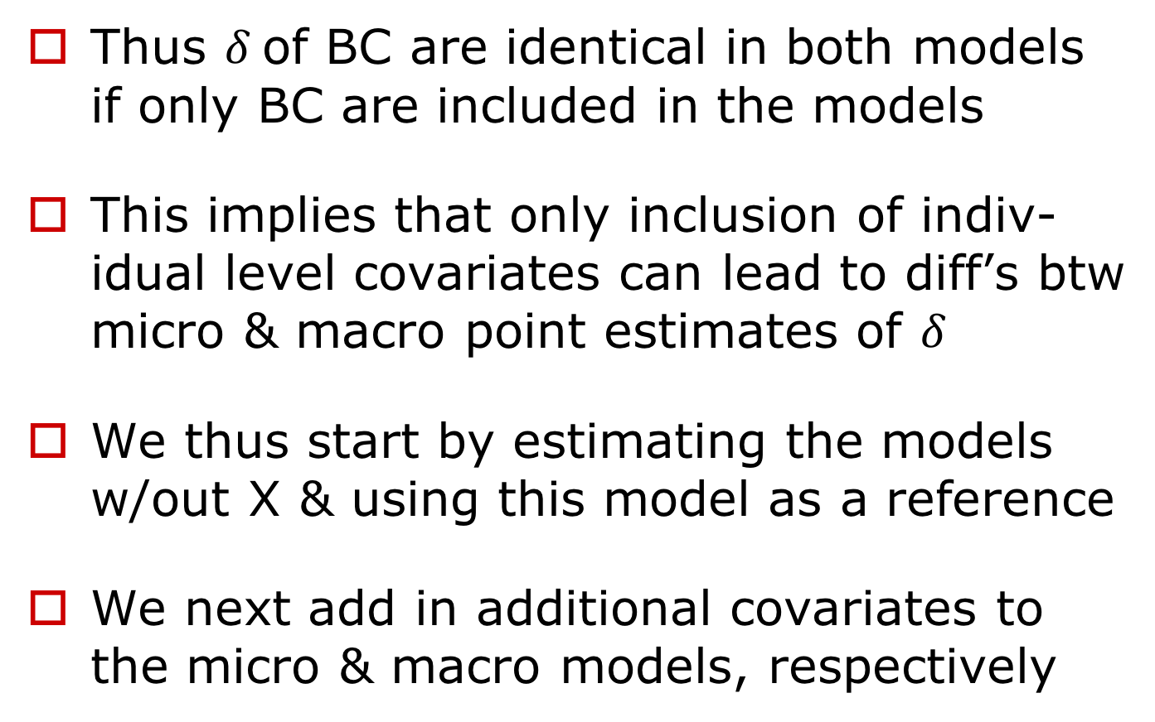
Methods
Thus $δ$of BC are identical in both models if only BC are included in the models
This implies that only inclusion of indiv-idual level covariates can lead to diff’s btw micro & macro point estimates of $δ$
We thus start by estimating the models w/out X & using this model as a reference
We next add in additional covariates to the micro & macro models, respectively

Slide 9
Data material
Are mainly from Statistics Sweden & the National Board of Health & Welfare (mortality)
The data from Statistics Sweden are from ”Longitudinal integration database for health insurance & labor market studies” 1993-2007
We use a 20% random sample of the total male population aged 20-64 yrs, located in the 21 counties of Sweden
In addition to the individual level data, county level macroeconomic data on unemployment rates is collected from Statistics Sweden

Slide 10
County-specific trends

Slide 12
Trends in unemp rates

Slide 13
Results I: Main analysis

Slide 14

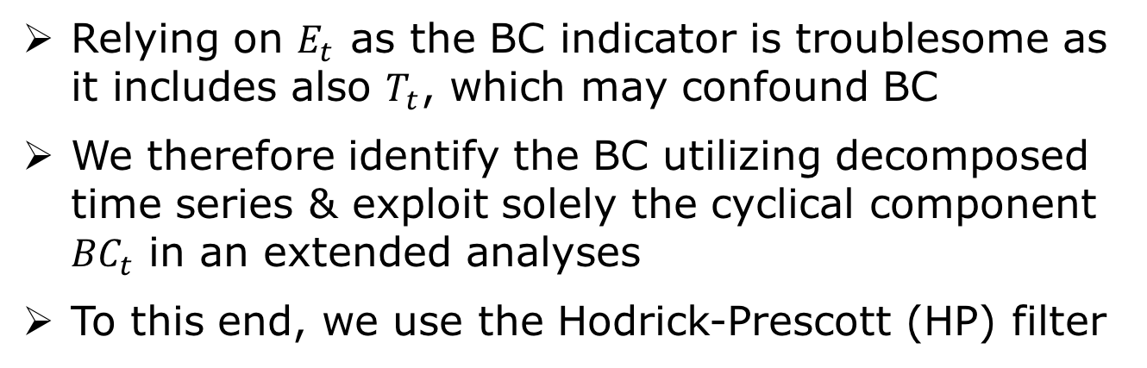
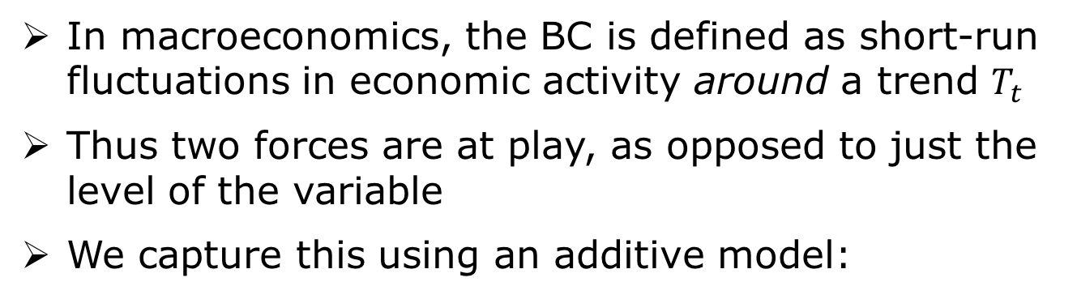
“Finetuning” the BC indicator
In macroeconomics, the BC is defined as short-run fluctuations in economic activity around a trend $T_{t}$
Thus two forces are at play, as opposed to just the level of the variable
We capture this using an additive model:
$$E_{t}=T_{t}+{BC}_{t}$$
Relying on $E_{t}$ as the BC indicator is troublesome as it includes also $T_{t}$, which may confound BC
We therefore identify the BC utilizing decomposed time series & exploit solely the cyclical component ${BC}_{t}$ in an extended analyses
To this end, we use the Hodrick-Prescott (HP) filter

Slide 15
Trend & cycle using UR

Slide 16
Robustness analysis I

Slide 17
Robustness analysis II

Slide 18
Robustness analysis III

Slide 19
Discussion & conclusion
Pro-cyclical mortality effects of similar size at both the individual level & the regional level age 20-44
This suggests that it is NOT the different levels of analyses that drive some of the conflicting findings in the literature (as we thought…)
Our estimates at both levels suggest that a 1 std dev increase in the UR reduces mortality by around 12% among 20-44 year old males but we find no effect on 45-64 year old males
We find also a SES gradient in the response to the BC fluctuations, i.e. BC appear only to affect poor & less educated people in the younger part of the labor force & this may be due to less job security

Slide 20
Next project
Register data on total population 20-29 year olds in Sweden during 2001-2013
Mental ill-health & substance abuse (narcotics, alcohol & tobacco; outpatient & inpatient, pharmaceuticals consumption, death by suicide)
Male & females, SES, foreign
Asymmetric effects of upturns- & downturns, alternative lag structure

