Slide 1


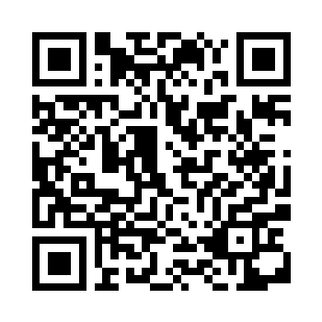
ORGANISERS
Bielefeld University (Germany) Örebro Universitet (Sweden) University of Jaén (Spain)
WHEN TO APPLY?
Contact your home University for more information on how to apply.
WHO SHOULD APPLY?
Bachelor, master and PhD students, who have interest in digital transformation, entrepreneurship and international perspectives.
HOW MUCH DOES IT COST?
There is no fee/tuition for the course Costs for travel, accommodation and food during the on-site week is paid by the student Contact your home university for information on Erasmus+ scholarship for participation
QUALIFICATIONS TO BE OBTAINED
Certificate on 3 ECTS credits
Focus Academy
Blended intensive programme (BIP)
Digital Transformation and Entrepreneurship
The power of innovation as a driver of sustainable economic change
Virtual Period: November & December 2025 Physical Mobility: November 24 - 28, 2025 in Bielefeld
Are you interested in digital transformation?
Are you curious about the opportunities digitalization might offer to address the todays issues?
Do you want to meet students from all over Europe in Bielefeld (Germany) to discuss these topics for a week in November 2025?
Why are digital transformation processes nowadays of importance for start-ups, mature companies as well as society? How might major challenges such as climate change and social inequality be addressed with solutions from digital technologies? Or might they even make everything worth? How do entrepreneurs benefit from digitalization? And what can we learn from entrepreneurship and innovation management for these transformation processes?
Together we want to approach the topic of digital transformation not only from a theoretical perspective, but we will also work on a real-world challenge.
Online preparatory session
Nov. 3rd
On-site week in Bielefeld
Nov. 24th-28th
Online workshop II
Dec. 15th
Online workshop I
Nov. 10th
Async. online-phase
Nov.

